Slide 1
CLINICAL MANAGEMENT OF COVID- 19
By
Dr. Tarun Lall
Senior Professor
Medical Officer Incharge 300 Bedded ICU
Rajasthan University of Health Sciences
Nodal Officer Incharge Trauma Center
Sawai Mansingh Medical College & Associated Group of Hospitals

Slide 2
INTRODUCTION
Coronavirus disease 2019 (COVID-19) is caused by the severe acute respiratory syndrome coronavirus 2 (SARS-CoV-2), a newly emergent coronavirus, that was first recognized in Wuhan, Hubei province, China, in December 2019. SARS-CoV-2 is a positive-sense single-stranded RNA virus that is contagious in humans.
Epidemiology and virologic studies suggest that transmission mainly occurs from both symptomatic and asymptomatic people to others by close contact through respiratory droplets or by direct contact with infected persons, or by contact with contaminated objects and surfaces
biological samples from confirmed patients demonstrate that shedding of SARS-CoV-2 is highest in the upper respiratory tract (URT) (nose and throat) early in the course of the disease (8,9,10), within the first 3 days from onset of symptoms
The incubation period for COVID-19, which is the time between exposure to the virus (becoming infected) and symptom onset, is, on average, 5–7 days, but can be up to 14 days. During this period, also known as the “presymptomatic” period, some infected persons can be contagious, from 1–3 days before symptom onset
In those patients that do become symptomatic, most people with COVID-19 develop only mild (40%) or moderate (40%) disease (see Table 6.3), approximately 15% develop severe disease that requires oxygen support, and 5% have critical disease with complications such as respiratory failure, acute respiratory distress syndrome (ARDS), sepsis and septic shock, thromboembolism, and/or multiorgan failure, including acute kidney injury and cardiac injury

Slide 3
Medicine Paediatrics and Anesthesia Departments work together
1. | Screening, triage and clinical assessment :
2. | Laboratory Diagnosis
3. | Management of Mild COVID-19 symptomatic treatment
4. | Management of Moderate COVID-19 pneumonia treatment
5. | Management of Severe COVID-19 severe pneumonia treatment
6. | Management of Critical COVID-19 : Acute respiratory discreet syndrome
7. | Management of Critical COVID-19 : Septic shook
8. | Prevention of complication in hospitalized and critically III patients with COVID -19
9. | Thromboembolism
10. | Neurological and Mental Menifestasions
11. | Therapeutics
Respiratory Management | Summary
1. | Nasal Prongs/ Oxygen Moustche
2. | Face Mask
3. | Prone Positioning with Non rebirthing Mask
4. | High Flow Nasal Oxygen(HFNC)
5. | Prone Position with High Flow Nasal Oxygen(HFNC)
6. | Non Invasive Ventilation
7. | CPAP Continuous positive airway pressure (CPAP)
8. | Bi-level Positive airway pressure
9. | Invasive Ventilation
10. | Primary Ventilator modes Assist/ Control (A/C) mode Synchronous Intermittent Mandatory Ventilation (SIMV)
11. | Secondary Ventilator modes Airway pressure release ventilation(APRV) Pressure regulated volume control (PRVC)

Slide 4
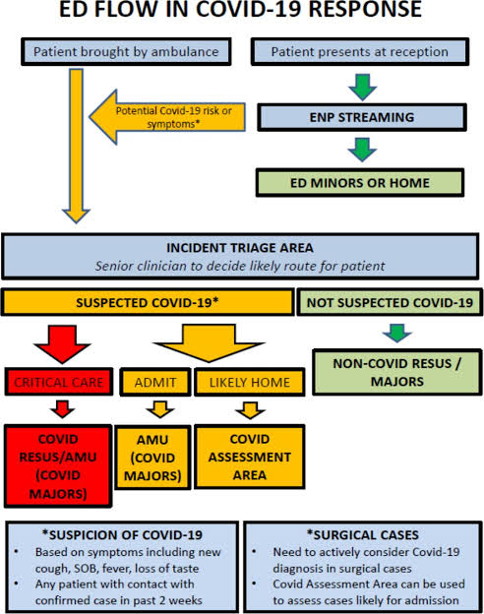
SCREENING, TRIAGE AND CLINICAL ASSESSMENT

Slide 5
Age more than 60 years (increasing with age)
Underlying noncommunicable diseases (NCDs): diabetes, hypertension, cardiac disease, chronic lung disease, cerebrovascular disease, dementia, mental disorders, chronic kidney disease, immunosuppression, obesity and cancer have been associated with higher mortality (84,85).
In pregnancy, increasing maternal age, high BMI, non-white ethnicity, chronic conditions and pregnancy specific conditions such as gestational diabetes and pre-eclampsia.
Presenting signs and symptoms of COVID-19 vary
Most persons experience fever (83–99%), cough (59–82%), fatigue (44–70%), anorexia (40–84%), shortness of breath (31–40%), myalgias (11–35%). Other non-specific symptoms, such as sore throat, nasal congestion, headache, diarrhoea, nausea and vomiting, have also been reporte. Loss of smell (anosmia) or loss of taste (ageusia) preceding the onset of respiratory symptoms has also been reported .
Additional neurological manifestations reported include dizziness, agitation, weakness, seizures, or findings suggestive of stroke including trouble with speech or vision, sensory loss, or problems with balance in standing or walking .
Older people and immunosuppressed patients in particular may present with atypical symptoms such as fatigue, reduced alertness, reduced mobility, diarrhoea, loss of appetite, confusion, and absence of fever.
Symptoms such as dyspnoea, fever, gastrointestinal (GI) symptoms or fatigue due to physiologic adaptations in pregnant women, adverse pregnancy events, or other diseases such as malaria, may overlap with symptoms of COVID-19.
Children might not have reported fever or cough as frequently as adults .
RISK FACTORS ASSOCIATED WITH SEVERE DISEASE

Slide 6
Laboratory Diagnosis
ROUTINE INVESTIGATION= CBC, RFT, LFT
CONFIRMATARY INVESTIGATION= RTPCR
HRCT CHEST(REMDISIVIR)
TREATMENT DECIDING INVESTIGATIONS=
INTERLEUKIN 6 (TOCILIZUMAB),
D-DIMER (ANTIPLATELET DRUGS),
PROGNOSIS DECIDING = SERUM FERRITIN, SERUM PROCALCITION, LACTATE DEHYDROGENASE, ESR, CRP
COVID HRCT CHEST SCORE
RIGHT LUNG IS DIVIDED IN 3 LOBES
LEFT LUNG DIVIDED BY IN 2 LOBE
EACH LOBE IS HAVING SCORE OF 5
IF LOBE IS 20% INVOLVED THEN SCORE=1
IF LOBE IS 40% INVOLVED THEN SCORE40%=2
IF LOBE IS 60% INVOLVED THEN SCORE60%=3
IF LOBE IS 80% INVOLVED THEN SCORE80%=4
IF LOBE IS 100% INVOLVED THEN SCORE100%=5
BOTH THE LUNGS ARE 5 LOBES AND UPTO 5 SCORE FOR EACH
LOBES THEN TOTAL MAXIMUM SCORE IS= 2
MILD DISEASE = BELOW 10
MODERATE DISEASE = 10 – 15
SEVERE DISEASE = ABOVE 15

Slide 7
COVID-19 DISEASE SEVERITY
Mild disease |  | Symptomatic patients meeting the case definition for COVID-19 without evidence of viral pneumonia or hypoxia. See the WHO website for most up-to-date case definitions .
Moderate disease | Pneumonia | Adolescent or adult with clinical signs of pneumonia (fever, cough, dyspnoea, fast breathing) but no signs of severe pneumonia, including SpO2 ≥ 90% on room air. Child with clinical signs of non-severe pneumonia (cough or difficulty breathing + fast breathing and/or chest indrawing) and no signs of severe pneumonia. Fast breathing (in breaths/min): < 2 months: ≥ 60; 2–11 months: ≥ 50; 1–5 years: ≥ 40. While the diagnosis can be made on clinical grounds; chest imaging (radiograph, CT scan, ultrasound) may assist in diagnosis and identify or exclude pulmonary complications. Caution: The oxygen saturation threshold of 90% to define severe COVID-19 was arbitrary and should be interpreted cautiously. For example, clinicians must use their judgment to determine whether a low oxygen

Slide 8
Severe disease | Severe pneumonia | Adolescent or adult with clinical signs of pneumonia (fever, cough, dyspnoea, fast breathing) plus one of the following: respiratory rate > 30 breaths/min; severe respiratory distress; or SpO2 < 90% on room air . Child with clinical signs of pneumonia (cough or difficulty in breathing) + at least one of the following: • Central cyanosis or SpO2 < 90%; severe respiratory distress (e.g. fast breathing, grunting, very severe chest indrawing); general danger sign: inability to breastfeed or drink, lethargy or unconsciousness, or convulsions. • Fast breathing (in breaths/min): < 2 months: ≥ 60; 2–11 months: ≥ 50; 1–5 years: ≥ 40. While the diagnosis can be made on clinical grounds; chest imaging (radiograph, CT scan, ultrasound) may assist in diagnosis and identify or exclude pulmonary complications.
Critical disease | Acute respiratory distress syndrome (ARDS) | Onset: within 1 week of a known clinical insult (i.e. pneumonia) or new or worsening respiratory symptoms. Chest imaging: (radiograph, CT scan, or lung ultrasound): bilateral opacities, not fully explained by volume overload, lobar or lung collapse, or nodules. Origin of pulmonary infiltrates: respiratory failure not fully explained by cardiac failure or fluid overload. Need objective assessment (e.g. echocardiography) to exclude hydrostatic cause of infiltrates/oedema if no risk factor present. Oxygenation impairment in adults (89,91): • Mild ARDS: 200 mmHg < PaO2/FiO2a ≤ 300 mmHg (with PEEP or CPAP ≥ 5 cmH2O).b • Moderate ARDS: 100 mmHg < PaO2/FiO2 ≤ 200 mmHg (with PEEP ≥ 5 cmH2O).b • Severe ARDS: PaO2/FiO2 ≤ 100 mmHg (with PEEP ≥ 5 cmH2O).b Oxygenation impairment in children: note OI and OSI.c Use OI when available. If PaO2 not available, wean FiO2 to maintain SpO2 ≤ 97% to calculate OSI or SpO2/FiO2 ratio: • Bilevel (NIV or CPAP) ≥ 5 cmH2O via full face mask: PaO2/FiO2 ≤ 300 mmHg or SpO2/FiO2 ≤ 264. • MildARDS(invasively ventilated): 4 ≤ OI < 8 or 5 ≤ OSI < 7.5. • ModerateARDS(invasively ventilated): 8 ≤ OI < 16 or 7.5 ≤ OSI < 12.3. • SevereARDS(invasively ventilated): OI ≥ 16 or OSI ≥ 12.3.

Slide 9
COVID-19 DISEASE SEVERITY
Sepsis | Adults: acute life-threatening organ dysfunction caused by a dysregulated host response to suspected or proven infection. Signs of organ dysfunction include: altered mental status (delirium), difficult or fast breathing, low oxygen saturation, reduced urine output (92), fast heart rate, weak pulse, cold extremities or low blood pressure, skin mottling, laboratory evidence of coagulopathy, thrombocytopenia, acidosis, high lactate, or hyperbilirubinemia. Children: suspected or proven infection and ≥ 2 age-based systemic inflammatory response syndrome (SIRS) criteria,d of which one must be abnormal temperature or white blood cell count.
Septic shock | Adults: persistent hypotension despite volume resuscitation, requiring vasopressors to maintain MAP ≥ 65 mmHg and serum lactate level > 2 mmol/L. Children: any hypotension (SBP < 5th centile or > 2 SD below normal for age) or two or three of the following: altered mental status; bradycardia or tachycardia (HR < 90 bpm or > 160 bpm in infants and heart rate < 70 bpm or > 150 bpm in children); prolonged capillary refill (> 2 sec) or weak pulse;
Acute thrombosis | Acute venous thromboembolism (i.e. pulmonary embolism), acute coronary syndrome, acute stroke.

Slide 10
COVID-19 DISEASE SEVERITY
MULTISYSTEM INFLAMMATORY SYNDROME IN CHILDREN (MIS-C ) | Preliminary case definition: children and adolescents 0–19 years of age with fever > 3 days AND two of the following: Rash or bilateral non-purulent conjunctivitis or muco-cutaneous inflammation signs (oral, hands or feet). Hypotension or shock. Features of myocardial dysfunction, pericarditis, valvulitis, or coronary abnormalities (including echo findings or elevated troponin/nt-probnp). Evidence of coagulopathy (by pt, ptt, elevated d-dimers), Acute gastrointestinal problems (diarrhoea, vomiting, or abdominal pain). And elevated markers of inflammation such as esr, c-reactive protein, or procalcitonin. And no other obvious microbial cause of inflammation, including bacterial sepsis, staphylococcal or streptococcal shock syndromes. And evidence of covid-19 (rt-pcr, antigen test or serology positive), or likely contact with patients with covid-19.

Slide 11
Management of mild COVID-19: symptomatic treatment
WHO Recommendations
Suspected or confirmed mild COVID-19 be isolated
mild COVID-19 be given symptomatic treatment such as antipyretics for fever and pain, adequate nutrition and appropriate rehydration.
Counsel patients with mild COVID-19 about signs and symptoms of complications that should prompt urgent care.
antibiotic therapy or prophylaxis should not be used in patients with mild COVID-19.

Slide 12
MANAGEMENT OF MODERATE COVID-19: PNEUMONIA TREATMENT
WHO Recommendations
Patients With Suspected Or Confirmed Moderate COVID-19 (Pneumonia) Be Isolated
The Location Of Isolation Will Depend On The Established COVID-19 Care Pathway And Can Be Done At A Health Facility, Community Facility Or At Home.
The Decision On Location Should Be Made On A Case-by-case Basis And Will Depend On The Clinical Presentation, Requirement For Supportive Care, Potential Risk Factors For Severe Disease, And Conditions At Home, Including The Presence Of Vulnerable Persons In The Household.
For Patients At High Risk For Deterioration Isolation In Hospital Is Preferred.
Use Of Pulse Oximetry Monitoring At Home As Part Of A Package Of Care, Including Patient And Provider Education And Appropriate Follow-up
Antibiotics Should Be Prescribed Unless There Is Clinical Suspicion Of A Bacterial Infection.
Close Monitoring Of Patients With Moderate Covid-19 For Signs Or Symptoms Of Disease Progression. Provision Of Mechanisms For Close Follow Up In Case Of Need Of Escalation Of Medical Care Should Be Available

Slide 13
MANAGEMENT OF SEVERE COVID-19: SEVERE PNEUMONIA TREATMENT
WHO Recommendations
Immediate Administration Of Supplemental Oxygen Therapy To Any Patient With Emergency Signs During Resuscitation To Target Spo2 ≥ 94% And To Any Patient Without Emergency Signs And Hypoxaemia (I.E. Stable Hypoxaemic Patient) To Target Spo2 > 90% Or ≥ 92–95% In Pregnant Women.
Closely Monitor Patients For Signs Of Clinical Deterioration, Such As Rapidly Progressive Respiratory Failure And Shock And Respond Immediately With Supportive Care Interventions.
Awake Prone Positioning Of Severely Ill Patients Hospitalized With Covid-19 Requiring Supplemental Oxygen (Includes High-flow Nasal Oxygen) Or Non-invasive Ventilation (Conditional, Low Certainty Evidence).
Use Cautious Fluid Management In Patients With Covid-19 Without Tissue Hypoperfusion And Fluid Responsiveness.

Slide 14
MANAGEMENT OF CRITICAL COVID-19: ACUTE RESPIRATORY DISTRESS SYNDROME (ARDS)
WHO Recommendations
Mild ARDS, A Trial Of HFNO, Non-invasive Ventilation – Continuous Positive Airway Pressure (CPAP), Bilevel Positive Airway Pressure (Bipap) May Be Used.
Prompt Recognition Of Progressive Acute Hypoxaemic Respiratory Failure When A Patient With Respiratory Distress Is Failing To Respond To Standard Oxygen Therapy And Adequate Preparation To Provide Advanced Oxygen/Ventilatory Support.
Endotracheal Intubation Be Performed
Implementation Of Mechanical Ventilation Using Lower Tidal Volumes (4–8 Ml/Kg Predicted Body Weight [Pbw]) And Lower Inspiratory Pressures (Plateau Pressure < 30 Cmh2o).
In Adult Patients With Severe ARDS(Pao2/Fio2 < 150) Prone Ventilation For 12–16 Hours Per Day Is Recommended
Use A Conservative Fluid Management Strategy For ARDS Patients Without Tissue Hypoperfusion And Fluid Responsiveness.
In Patients With Moderate Or Severe ARDS, A Trial Of Higher Positive End-expiratory Pressure (Peep) Instead Of Lower Peep Is Suggested.
In Patients With Moderate-severe ARDS(Pao2/Fio2 < 150), Neuromuscular Blockade By Continuous Infusion Should Not Be Routinely Used.
Avoid disconnecting the patient from the ventilator, which results in loss of PEEP, atelectasis and increased risk of infection of health care workers.
In patients with excessive secretions, or difficulty clearing secretions, consider application of airway clearance techniques.
In settings with access to expertise in ECMO, consider referral of patients who have refractory hypoxaemia (e.g. including a ratio of partial pressure of arterial oxygen [PaO2] to the fraction of inspired oxygen [FiO2] of < 50 mmHg for 3 hours, a PaO2:FiO2 of < 80 mmHg for > 6 hours) despite lung protective ventilation.

Slide 15
MANAGEMENT OF CRITICAL COVID-19: SEPTIC SHOCK
Recognize septic shock in adults when infection is suspected or confirmed AND vasopressors are needed to maintain mean arterial pressure (MAP) ≥ 65 mmHg AND lactate is ≥ 2 mmol/L, in the absence of hypovolaemia.
Recognize septic shock in children with any hypotension (SBP < 5th centile or > 2 SD below normal for age) or two or more of the following: altered mental status; bradycardia or tachycardia (HR < 90 bpm or > 160 bpm in infants and HR < 70 bpm or > 150 bpm in children); prolonged capillary refill (> 2 sec) or feeble pulses; tachypnoea; mottled or cold skin or petechial or purpuric rash; increased lactate; oliguria; hyperthermia or hypothermia
In resuscitation for septic shock in adults, give 250–500 mL crystalloid fluid as rapid bolus in first 15–30 minutes
In resuscitation for septic shock in children, give 10–20 mL/kg crystalloid fluid as a bolus in the first 30–60 minutes.
Fluid resuscitation may lead to volume overload, including respiratory failure, particularly with ARDS. If there is no response to fluid loading or signs of volume overload appear (e.g. jugular venous distension, crackles on lung auscultation, pulmonary oedema on imaging, or hepatomegaly), then reduce or discontinue fluid administration. This step is particularly important in patients with hypoxaemic respiratory failure
Do not use hypotonic crystalloids, starches or gelatins for resuscitation.
In adults, administer vasopressors when shock persists during or after fluid resuscitation. The initial blood pressure target is MAP ≥ 65 mmHg in adults and improvement of markers of perfusion. In children, administer vasopressors if signs of fluid overload are apparent or the following persist after two fluid bolus:
signs of shock such as altered mental state;
bradycardia or tachycardia (HR < 90 bpm or > 160 bpm in infants and HR < 70 bpm or > 150 bpm in children);
prolonged capillary refill (> 2 seconds) or feeble pulses;
tachypnoea; mottled or cool skin or petechial or purpuric rash; increased lactate; oliguria persists after two repeat boluses;
age-appropriate blood pressure targets are not achieved.
If central venous catheters are not available, vasopressors can be given through a peripheral IV, but use a large vein and closely monitor for signs of extravasation and local tissue necrosis. If extravasation occurs, stop infusion. Vasopressors can also be administered through intraosseous needles.
If signs of poor perfusion and cardiac dysfunction persist despite achieving MAP target with fluids and vasopressors, consider an inotrope such as dobutamine

Slide 16
PREVENTION OF COMPLICATIONS
Thromboembolism
Neurological And Mental Manifestations
Adverse Effects Of Medications
Pneumothorax
Acute Coinfections With Bacteria

Slide 17
THROMBOEMBOLISM -----Coagulopathy is common in patients with severe COVID-19, and both venous and arterial thromboembolism have been reported
Monitor patients with COVID-19, for signs or symptoms suggestive of thromboembolism, such as stroke, deep venous thrombosis, pulmonary embolism or acute coronary syndrome. If these are clinically suspected, proceed immediately with appropriate diagnostic and management pathways.
Thromboprophylaxis ----Administer standard thromboprophylaxis dosing of anticoagulation
Adverse effects of medications Careful consideration should be given to the numerous, clinically significant side-effects of medications that may be used in the context of COVID-19, as well as drug-drug interactions between medications, both of which may affect COVID-19 symptomatology (including effects on respiratory, cardiac, immune and mental and neurological function).
Acute coinfections with bacteria
Use Of Empiric Antimicrobials To Treat All Likely Pathogens, Based On Clinical Judgment, Patient Host Factors And Local Epidemiology, And This Should Be Done As Soon As Possible (Within 1 Hour Of Initial Assessment If Possible), Ideally With Blood Cultures Obtained First. Antimicrobial Therapy Should Be Assessed Daily For De-escalation.

Slide 18
THERAPEUTICS AND COVID-19
Strong recommendations against the use of hydroxychloroquine and lopinavir/ritonavir in patients with COVID-19, regardless of disease severity.
A strong recommendation for systemic corticosteroids in patients with severe and critical COVID-19.
A conditional recommendation against systemic corticosteroids in patients with non-severe COVID-19.
A conditional recommendation against remdesivir in hospitalized patients with COVID-19.
We recommend that the use of unproven drugs not be administered as treatment or prophylaxis for COVID-19, outside of the context of clinical trials.

Slide 19
MANAGEMENT OF NEUROLOGICAL AND MENTAL MANIFESTATIONS ASSOCIATED WITH COVID-19
Delirium
Measures to prevent delirium, an acute neuropsychiatric emergency, be implemented; and patients be evaluated using standardized protocols, for the development of delirium. If detected, then immediate evaluation by a clinician is recommended to address any underlying cause of delirium and treat appropriately.
Stroke
Signs and symptoms of stroke can include weakness of limbs or face, sensory loss, speech difficulties, impairment of vision, ataxia, confusion, or decreased consciousness. Standard IPC measures must be followed during the clinical evaluation, neuroimaging or procedures for patients with stroke.

Slide 20
Mental Health And Psychosocial Support
Provide Basic Mental Health And Psychosocial Support (MHPSS) For All Persons With Suspected Or Confirmed COVID-19 By Asking Them About Their Needs And Concerns, And Addressing Them.
Prompt Identification And Assessment For Anxiety And Depressive Symptoms In The Context Of Covid-19 And To Initiate Psychosocial Support Strategies And First-line Interventions, For The Management Of New Anxiety And Depressive Symptoms.
Psychosocial Support Strategies As The First-line Interventions For Management Of Sleep Problems In The Context Of Acute Stress

Slide 21
REHABILITATION FOR PATIENTS WITH COVID-19
The following symptoms have been reported 4–8 weeks after discharge from the hospital in both ICU admitted COVID-19 patients and non-ICU admitted COVID-19 patients: new illness-related fatigue, breathlessness, PTSD symptoms, pain, voice change, cough, dysphagia, anxiety, depression, and problems with concentration, memory and continence.
Patients admitted to ICU had greater prevalence of symptoms in almost all reported symptom domains than COVID-19 patients not admitted to ICU (202). More than half of all COVID-19 patients who had been hospitalized, regardless of their clinical management, reported persistence of fatigue at 60 days since the onset of symptoms
Early findings report, most commonly reported ongoing symptoms (regardless of hospitalization status) are fatigue, muscle ache, shortness of breath and headache at a follow up of 4 months (205). Not returning to usual health within 2–3 weeks of testing was reported by approximately one third of symptomatic adults in an outpatient setting.
In addition, several complications from COVID-19 have been reported in different clinical domains, resulting from a thrombotic event (such as ischaemic stroke and ischaemic heart disease), direct invasion (such as myocarditis, myositis, and meningitis) or an immune-mediated reaction (such as Guillain-Barré syndrome).

Slide 22
COVID-19 is a multisystem disease which, in certain cases, will require full multidisciplinary team rehabilitation to enable recovery (208).
In hospitalized patients, during the acute phase of illness, rehabilitation professionals may provide interventions that relieve respiratory distress, prevent complications and support communication
Prior to hospital discharge, COVID-19 patients should be screened for rehabilitation needs in order to facilitate onward referral.
Patients with COVID-19, should be provided with education and support for the selfmanagement of breathlessness and resumption of activities, both in a hospitalized and a non-hospitalized setting caring for COVID-19.
For patients who have been discharged from the hospital or patients who have been managed at home and experience persistent symptoms and/or limitations in functioning, screen for physical, cognitive and mental impairments, and manage accordingly.
Provide individualized rehabilitation programmes from subacute to long term according to patient needs. The prescription and provision of rehabilitation programmes should be guided by persistent symptoms and functional limitations

Slide 23
ICU and Ventilator Management for COVID-19 Patients

Slide 24
COVID-19 pneumonia, Type L
Low elastance.
Low ventilation-to-perfusion (VA/Q) ratio - Since the gas volume is nearly normal, hypoxemia may be best explained by the loss of regulation of perfusion and by loss of hypoxic vasoconstriction. Accordingly, at this stage, the pulmonary artery pressure should be near normal.
Low lung weight-Only ground-glass densities are present on CT scan, primarily located sub-Pleurally and along the lung fissures. Consequently, lung weight is only moderately increased.
Low lung Recruitability - Therefore, severe hypoxemia is primarily due to ventilation/perfusion (VA/Q) mismatch. High PEEP and prone positioning do not improve oxygenation through recruitment of collapsed areas.

Slide 25
COVID-19 pneumonia, Type H
High Elastance - The decrease in gas volume due to increased edema accounts for the increased lung elastance.
High right-to-left shunt- This is due to the fraction of cardiac output perfusing the non-aerated tissue which develops in the dependent lung regions due to the increased edema and superimposed pressure.
High lung weight- Quantitative analysis of the CT scan shows a remarkable increase in lung weight (> 1.5 kg), on the order of magnitude of severe ARDS.
High lung Recruitability- The increased amount of non-aerated tissue is associated, as in severe ARDS, with increased recruitability. The Type H pattern, 20–30% of patients in our series, fully fits the severeARDScriteria: hypoxemia, bilateral infiltrates, decreased the respiratory system compliance, increased lung weight and potential for recruitment.

Slide 26
Type L ( Type 1) patients:
PEEP levels should be kept lower in patients with high pulmonary compliance.
Tidal volume thresholds should not be limited at 6 ml/kg.
Respiratory rate should not exceed 20 breaths/min.
Patients should be left “quiet”; avoiding doing too much is of higher benefit than intervening at any cost.
Type H (Type 2) patients:
Standard treatment for severeARDSshould be applied (lower tidal volume, prone positioning, and relatively high PEEP).

Slide 27
Respiratory management Goals of Oxygen therapy
1. Target saturation SpO2 92%-96%.
2. Maintain stable work of breathing:
Goal respiratory rate < 24.
Target normal respiratory effort (no signs of accessory muscle use or obvious increased respiratory work).
3. Supplemental oxygen support:
Initial oxygen delivery should be humidified nasal cannula (NC) titrated from 1 to 6 LPM to meet goals of therapy.
If goals of therapy are not met at 6 LPM NC then advance to either:
Oxymizer mustache- Initiate at 6 LPM. Titrate to maximum of 12 LPM to meet goals of therapy.
Venturi mask - Initiate at 12 LPM and FiO2 40%. Titrate to maximum of FiO2 60% to meet goals of therapy.

Slide 28
Respiratory management
Start by oxygen mask 5 L/min. ➢
Escalate to face mask with bag 10-15 L/min.
Consider awake prone positioning with non-rebreathing mask.
Criteria of failure of oxygen therapy with face mask.
Respiratory rate > 30 /min and SPo2 < 90% or PaO2 < 60 mmHg.
Escalate oxygen therapy to high flow nasal oxygen (HFNC): -
Start by FIO2 100%.
Flow rate start @ 40 L/min to minimize aerosol spread and escalate to 60 L/min.
Consider prone position with HFNC.
Monitor for 1 to 2 hours, if reached the target continue on HFNC.
if failed or HFNC is not available short trial of non-invasive ventilation.

Slide 29
Non-Invasive Ventilation
NIPPV: Initiation of NIPPV (bilevel positive airway pressure [BiPAP]/ continuous positive airway pressure [CPAP]) requires attending approval.
Rare exceptions are -
No intubation for those with acute indications for NIV or HFNC.
Patients who use NIV chronically or are currently stable or improving on NIV or HFNC.
Exacerbations that are expected to have a rapid reversal such as congestive heart failure.
Extubation failure or high risk for reintubation.
Equipment shortages in which milder disease could be managed to save invasive ventilation devices.

Slide 30
Non-Invasive Ventilation
Use of non-invasive ventilation is controversial. ➢
Because the atelectasis is the main cause of hypoxemia in these patients, CPAP is preferred over BiPAP.
Initial settings for high level of CPAP 13-15 cmH2O.
Titrate FiO2 against oxygen saturation. ➢ Falling FiO2 indicate successful therapy.
Predictors of failure (the patient should be evaluated within 30-60min after starting NIV)
High Tidal volume exceeding 9.5 ml/kg predicts excess work of breathing
Progressive worsening of blood gases.
Increase work of breathing.

Slide 31
Non-Invasive Ventilation
NIV is continuous positive airway pressure (CPAP) or bi-level positive airway pressure delivered via a tight- fitting mask.
Not generally recommended for treatment of patients with ARDS
May preclude achieving low tidal volumes and adequate PEEP level.
complications:
facial skin breakdown,
poor nutrition,
failure to rest respiratory muscles. If used, apply airborne precautions.
It can be difficult to achieve a tight-fit with face masks in children and infants.

Slide 32
Non-Invasive Ventilation
Some experts use NIV in carefully selected patients with mild ARDS
stable haemodynamics, few secretions,
without urgent need for intubation.
Can be used as a temporizing measure until IMV is initiated.
If NIV tried and unsuccessful, do not delay intubation: i.e. inability to reverse gas exchange dysfunction within 2–4 hours.

Slide 33
Escalation to invasive ventilation (GAP)
G: Gas exchange abnormality:
COVID-19 respiratory failure is usually hypoxemic, not hypercarbic.
Worsening oxygenation: PaO2/FIO2 or SpO2/FiO2 <150.
NIV with FIO2 >0.6 and can’t maintain SpO2 >90%.
Oxygenation unresponsive to HFNC therapy.
Hypercapnia with acidosis, pH <7.3.
Increased work of breathing suggests deterioration of respiratory function.
A: Airway protection:
Altered mental status attributed to respiratory failure.
Neurological dysfunction.
P: Pulmonary toilet:
Increased airway secretions.

Slide 34
1).Worsening Hypercarbia.
2).Acidemia.
3).Altered Mental Status.
4).Fatigue.
5).Hemodynamic Instability.
Indications Of Mechanical Ventilation:
1.Respiratory Exhaustion.
2.Refractory Severe Hypoxemia (Pao2 <50-60 Mmhg) On Maximal
Oxygen Therapy.
3. Progressive CO2 Retention With Academia.
4.Failure Of NIV.
5.Non-respiratory Indications Especially Refractory Hemodynamic
Compromise And Deep Coma.
INDICATION OF INTUBATION:

Slide 35
Ventilatory management protocol:
Calculate Ideal Body Weight
Set Initial respiratory rate Typical starting rates will be 16-24 titrated to goal minute ventilation of 5-8 L/min.
Consider starting rates of 24-28 titrated to goal minute ventilation of 8-12 L/min in setting of acidosis (pH < 7.25) pre-intubation.
Initial settings Ventilator settings:
Lung protective ventilation
Initial mode of ventilation: Assist control/ PRVC
Tidal volume: 6 mL/kg PBW (calculate this from height and gender)
Male patients: 50 + 2.3 [height (inches) – 60]
Female patients: 45.5 + 2.3 [height (inches) – 60]
Measure inspiratory plateau pressure, 0.5 sec inspiratory pause every 4 hours and after each change in PEEP or VT.
If Pplat >30 cmH2O ,decrease VT to5 or to 4 mL/kg
If Pplat < 25 cm H2O and VT < 6mL/kg , increase VT by 1 ml/kg PBW

Slide 36
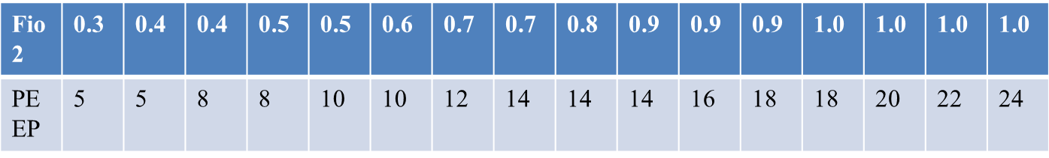
Respiratory rate: 20-25 (Consider patients’ preintubation respiratory rate)
Goal:
Limit overdistention of alveoli and ensure adequate oxygenation and ventilation.
Overdistention causes inflammation, organ dysfunction, decreased venous return,
and worsens ARDS.
Try to avoid 100% oxygen, which favors de-nitrogen atelectasis
I:E ratio: acceptable range 1:2 to 1:3
FiO2,PEEP, arterial oxygenation:
Maintain PaO2 = 60- 80mmHg or SpO2 =88-95% using following PEEP/FiO2 combinations

Slide 37
Modes of ventilation
Primary ventilator modes
Assist/control (A/C) mode: The ventilator delivers a set minimum number of mandatory breaths each minute. A/C mode can be used with either pressure control or volume control.
Synchronous intermittent mandatory ventilation (SIMV) mode: The ventilator delivers a set minimum number of mandatory breaths each minute but also allows the patient to breathe spontaneously in between the mandatory breaths. SIMV can be used with either pressure control or volume control.

Slide 38
Modes of ventilation
Secondary ventilator modes
1.Airway pressure release ventilation (APRV): APRV is an applied continuous positive airway pressure that at a set timed interval releases the applied pressure. Occasionally used in those with severe acute respiratory distress syndrome (ARDS).
2. Pressure regulated volume control (PRVC): This is a pressure- controlled mode but adds a targeted tidal volume, so the inspiratory pressure changes breath-to-breath to achieve the targeted tidal volume.

Slide 39
Refractory hypoxemia
Call for help early
Consider proning to improve V/Q ratio mismatch
Assess cardiac function (myocarditis and cardiomyopathy are reported)
Consider nitric oxide to improve V/Q ratio mismatch
Consider paralysis
Patient must be sedated with a benzodiazepine or propofol; analgesics do not provide amnesia for paralysis.
Consider extracorporeal membrane oxygenation (ECMO)

Slide 40
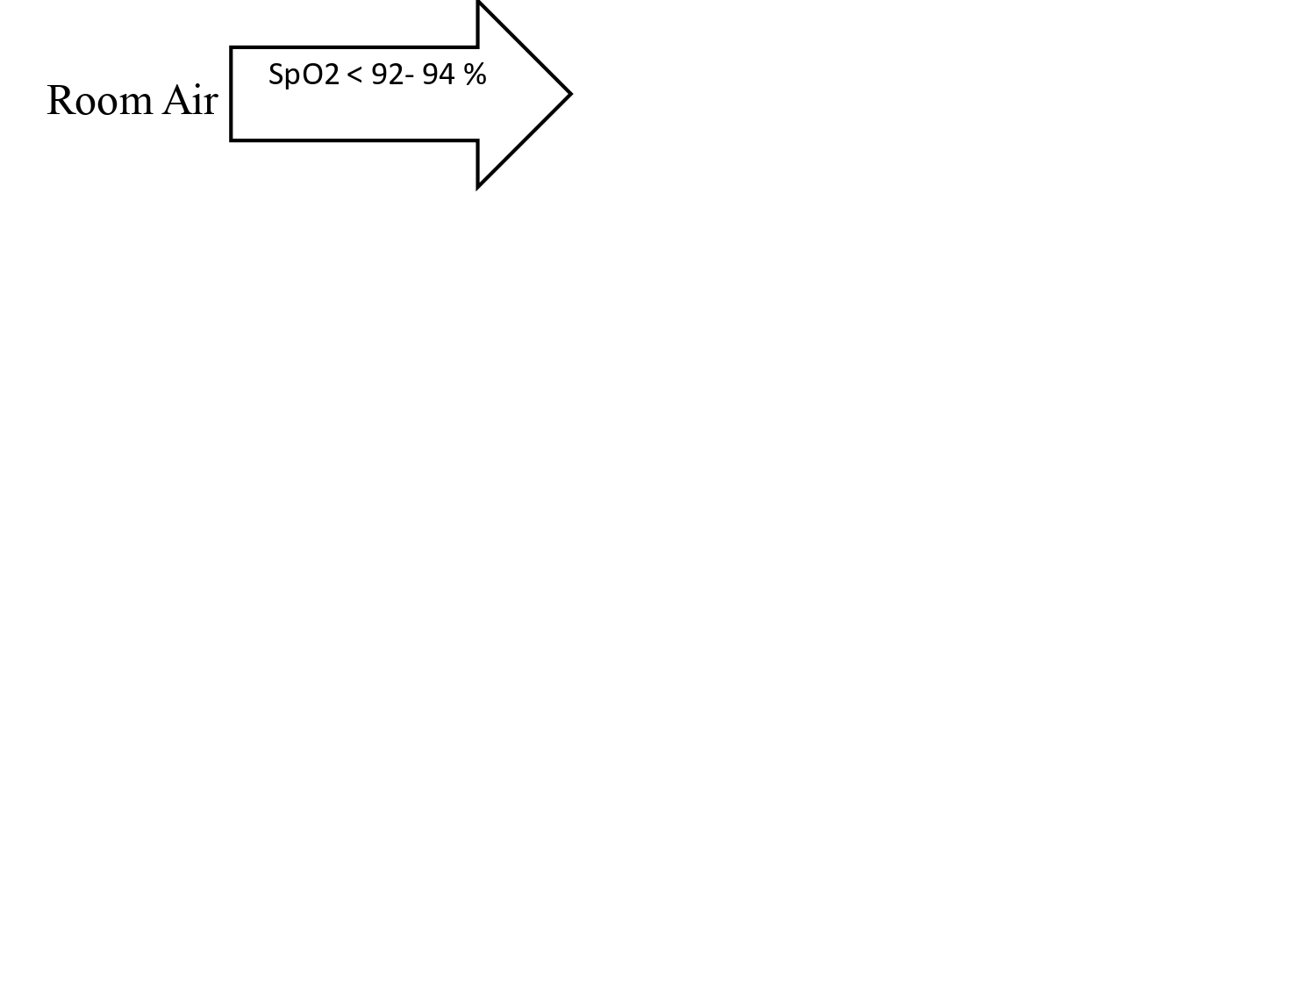

Slide 41
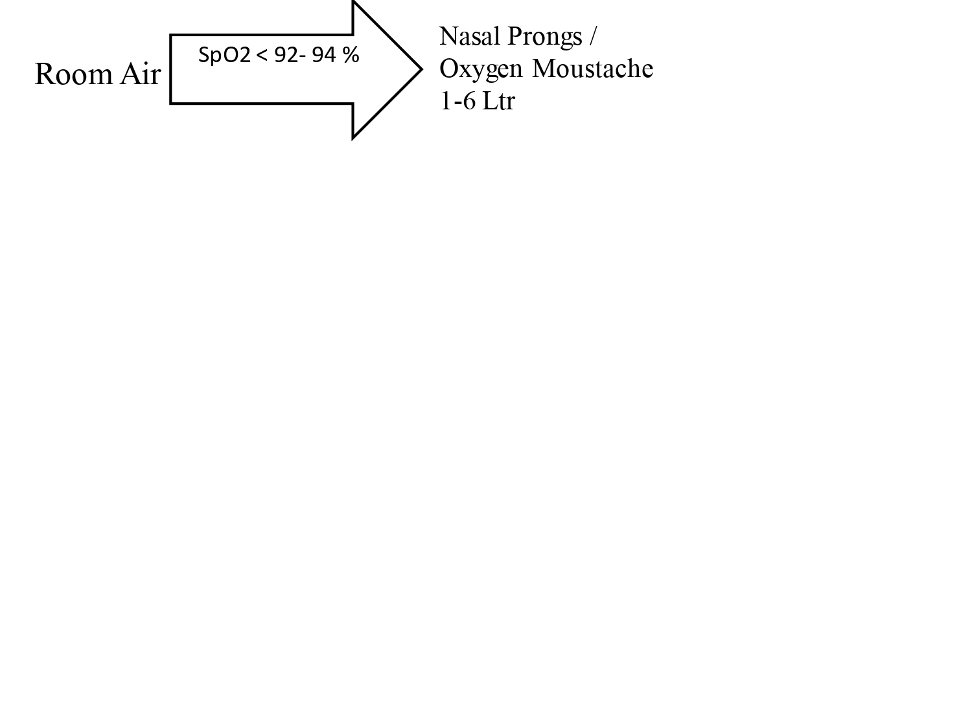

Slide 42
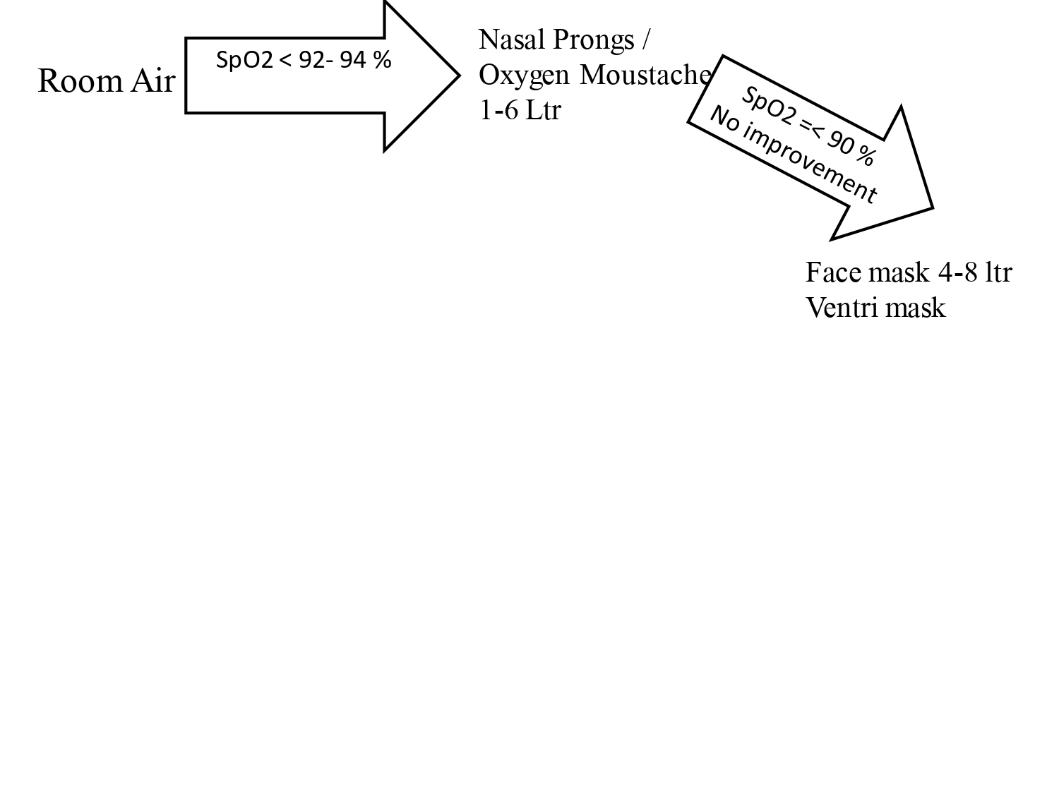

Slide 43
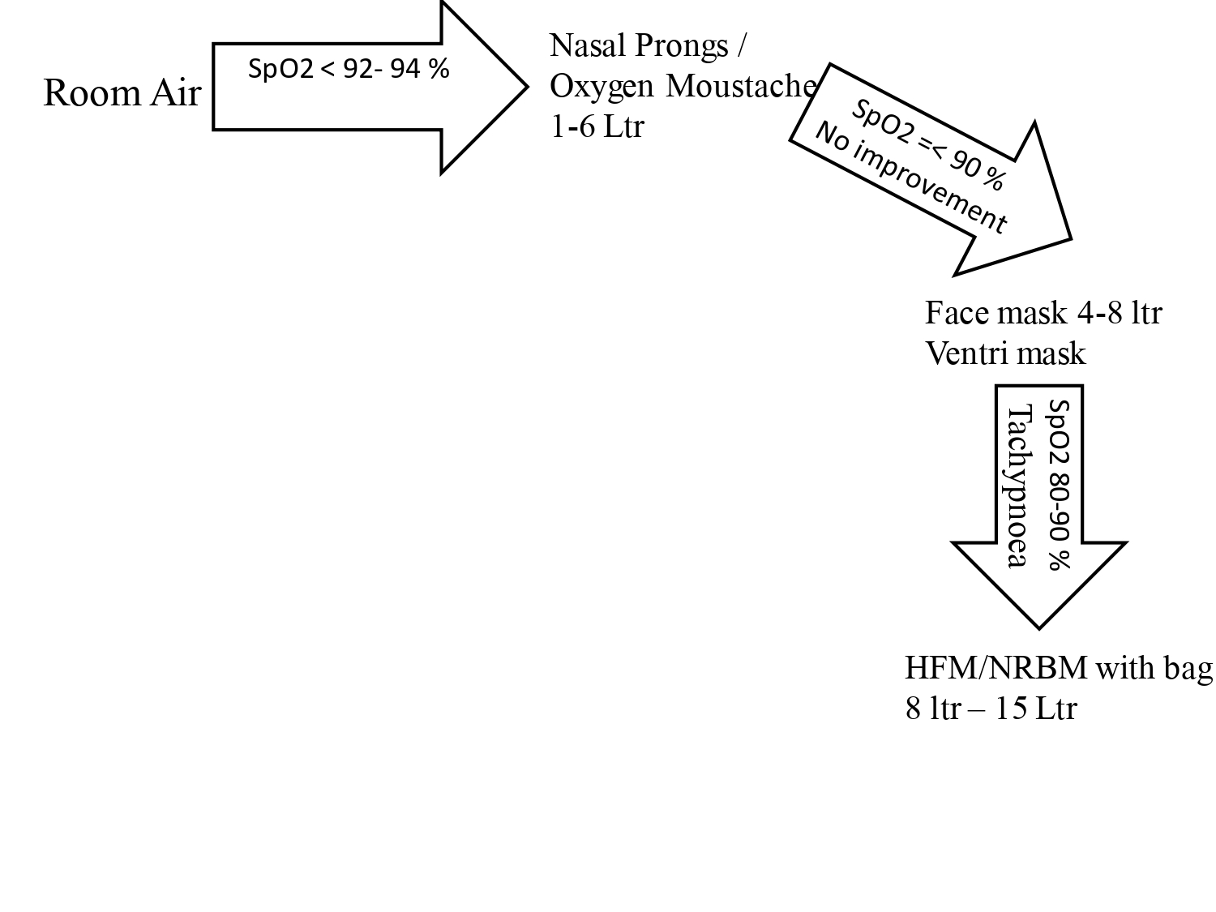

Slide 44
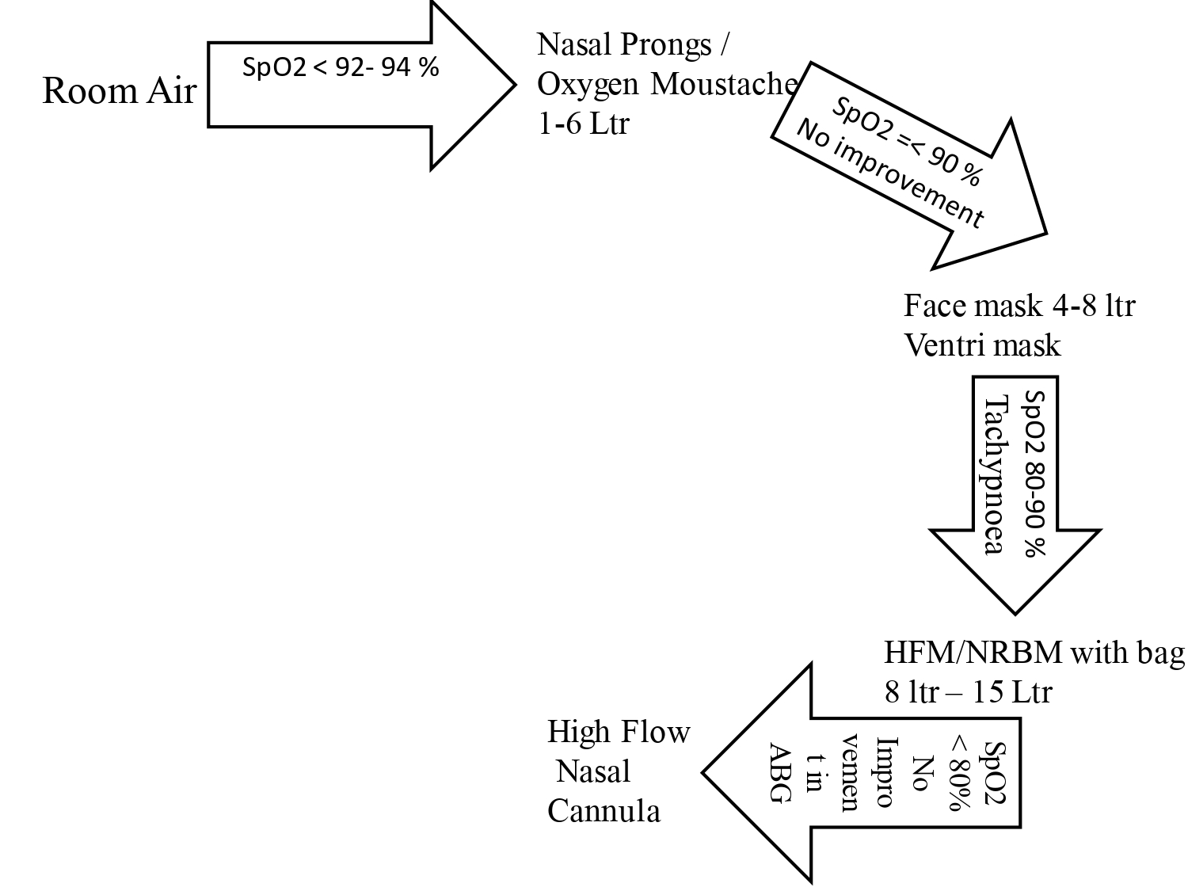

Slide 45
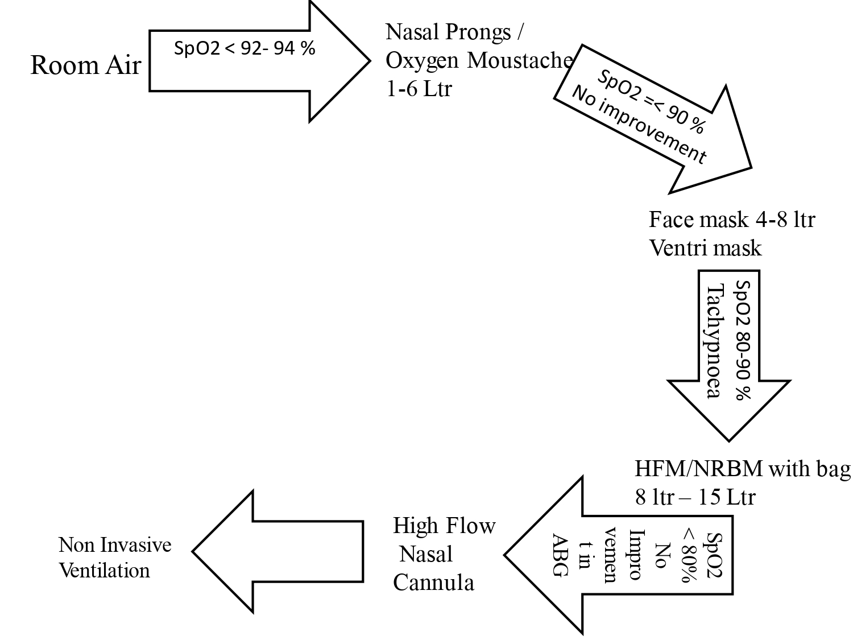

Slide 46
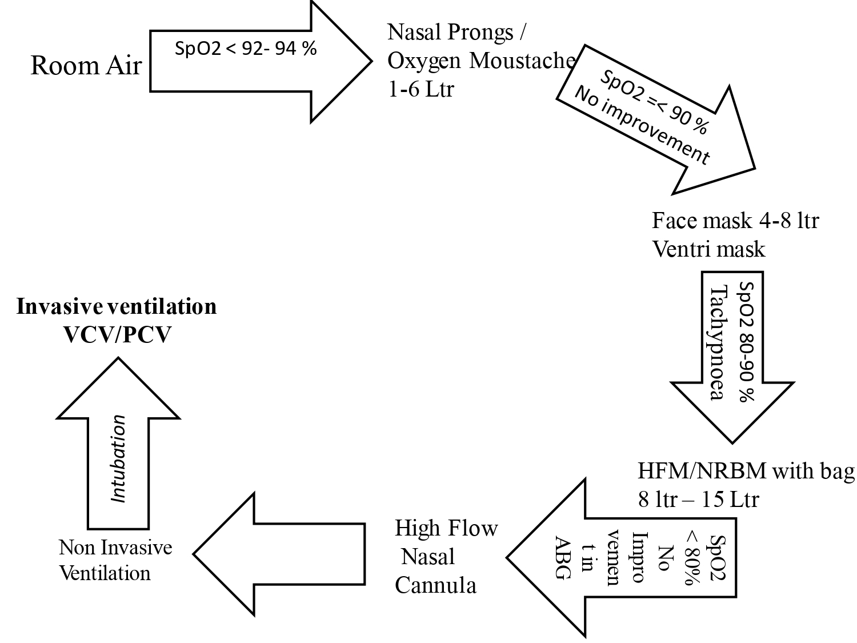

Slide 47
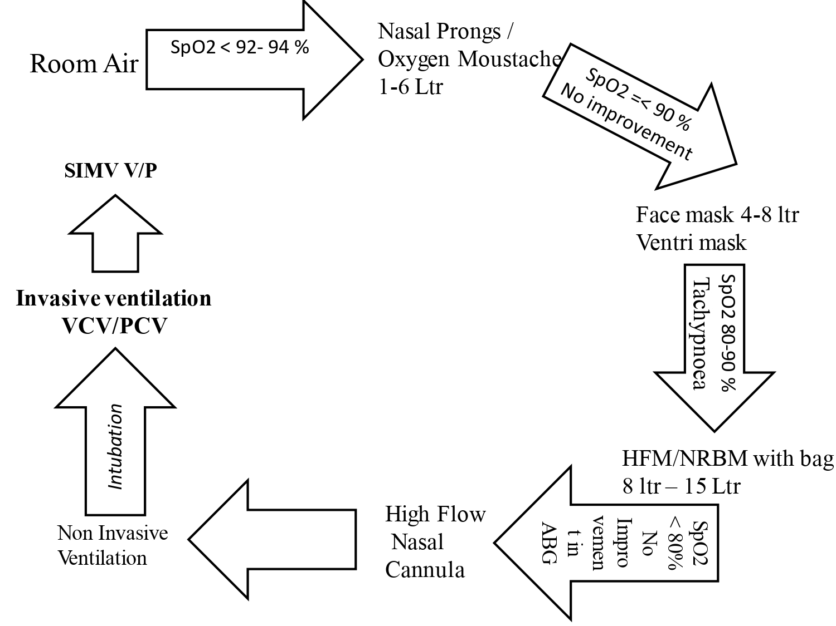

Slide 48
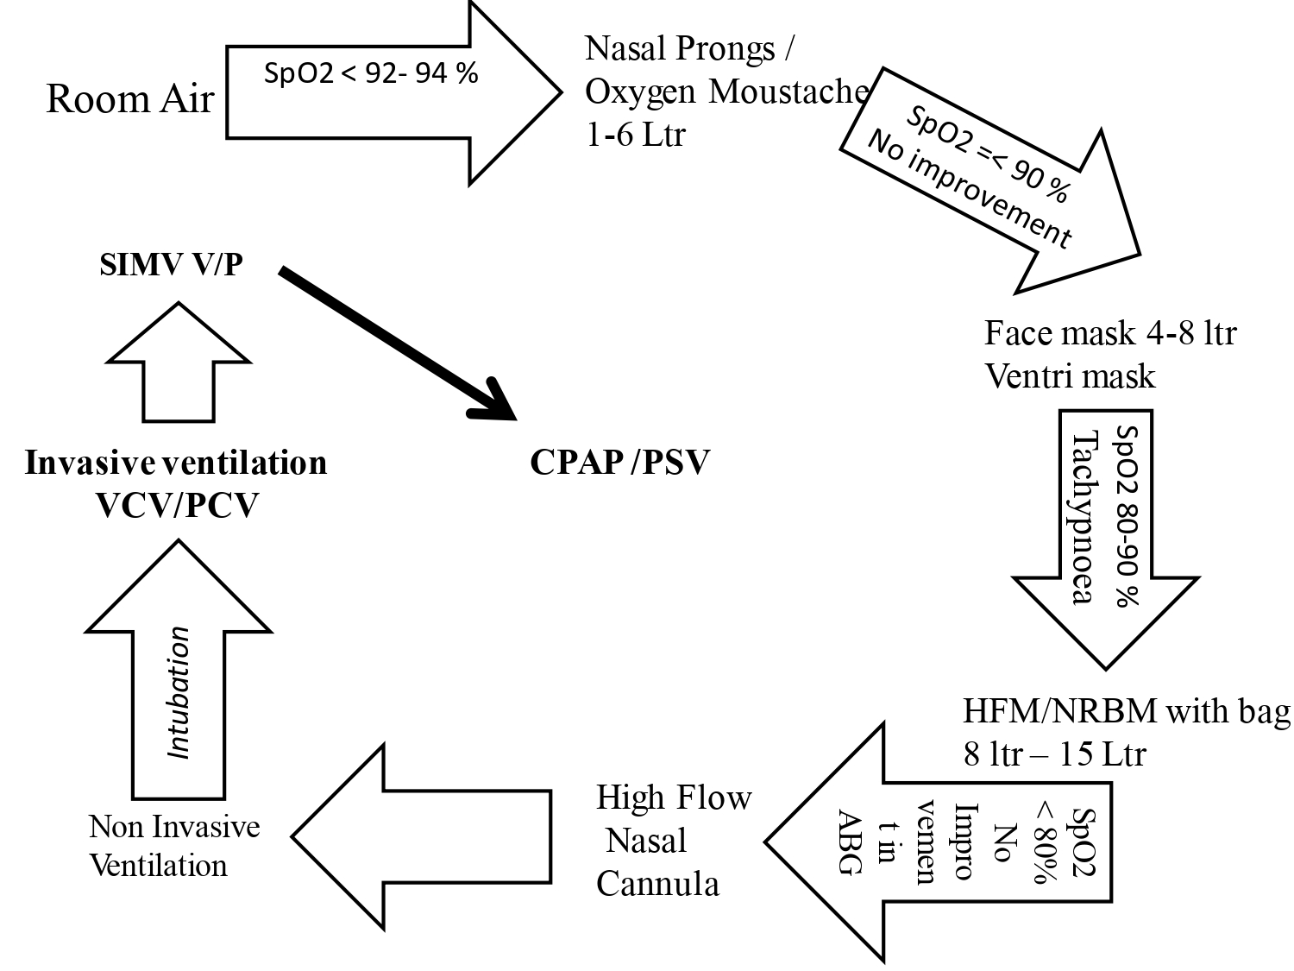

Slide 49
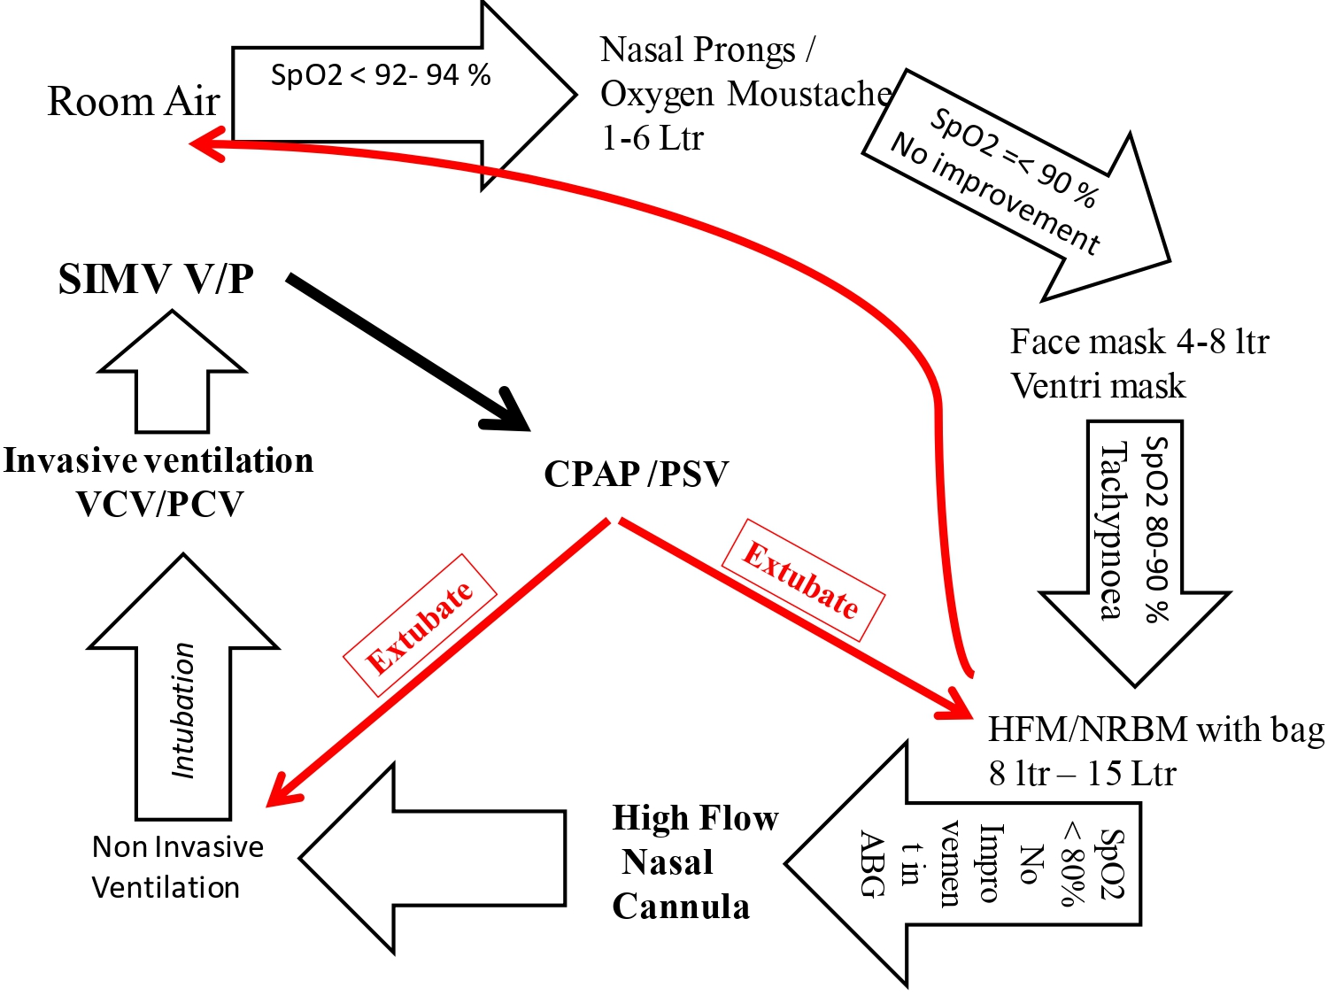

Slide 50


Slide 51
CARING FOR WOMEN WITH COVID-19 DURING AND AFTER PREGNANCY
all pregnant women with history of contact with a person with confirmed COVID-19 be carefully monitored considering asymptomatic transmission of COVID-19.
Pregnant or recently pregnant women with suspected or confirmed mild COVID-19 may not require acute care in hospital, unless there is concern for rapid deterioration or an inability to promptly return to hospital; but isolation to contain virus transmission is recommended
Pregnant or recently pregnant women with moderate or severe COVID-19 require acute care in the hospital, as there is concern for rapid deterioration that may warrant supportive care for severe respiratory morbidity; and/or interventions to improve maternal and fetal survival.
Pregnant and recently pregnant women with suspected, probable or confirmed COVID-19, should have access to woman-centred, respectful skilled care, including midwifery, obstetric, fetal medicine and neonatal care, as well as mental health and psychosocial support, with readiness to care for maternal and neonatal complications
Mode of birth should be individualized, based on obstetric indications and the woman’s preferences. WHO recommends that induction of labour and caesarean section should only be undertaken when medically justified and based on maternal and fetal condition. COVID-19 positive status alone is not an indication for caesarean section.
Pregnant and recently pregnant women who have recovered from COVID-19 and been released from the COVID-19 care pathway, should be enabled and encouraged to receive routine antenatal, postpartum, or postabortion care, as appropriate. Additional care should be provided if there are any complications

Slide 52
FEEDING AND CARING FOR INFANTS AND YOUNG CHILDREN OF MOTHERS WITH COVID-19
Mothers with suspected or confirmed COVID-19 should be encouraged to initiate and continue breastfeeding. From the available evidence, mothers should be counselled that the benefits of breast-feeding substantially outweigh the potential risks of transmission.

Slide 53
SUMMARY OF RECOMMENDATIONS WHEN MOTHER WITH COVID-19 IS CARING FOR INFANT
 | Interventions
Mother infant contact at birth | Mothers should not be separated from their infants unless the mother is too sick to care for her baby. If the mother is unable to care for the infant another competent fa- mily caregiver should be identified. Mother and infant should be enabled to remain together while rooming-in throughout the day and night and practise skin-to-skin contact, including kangaroo mother care, especially immediately after birth and during establishment of breastfeeding, whether they or their infants have suspected or confirmed COVID-19 virus infection. Neonates born to mothers with suspected or confirmed COVID-19 should be breastfed within 1 hour of birth. Mothers should apply appropriate IPC. Early and uninterrupted skin-to-skin contact between mothers and infants should be facilitated and encouraged as soon as possible after birth, while applying necessary measures for IPC. This applies also to infants who are born preterm or low birth weight. If the newborn or infant is ill and requires specialist care (such as neonatal unit), arrangements should be made to allow the mother free access to the unit, with appropriate IPC measures. Earlier initiation of breastfeeding results in greater benefits. This may be relevant to mothers who give birth by caesarean section, after an anaesthetic, or those who have medical instability that precludes initiation of breastfeeding within the first hour after birth.

Slide 54
SUMMARY OF RECOMMENDATIONS WHEN MOTHER WITH COVID-19 IS CARING FOR INFANT
During early childhood | Infants should be breastfed exclusively during the first 6 months after birth, as breastmilk provides all the nutrients and fluids they need. From 6 months of age, breastmilk should be complemented with a variety of adequate, safe and nutrient-dense foods. Breastfeeding should continue up to 2 years of age or beyond. Breastfeeding counselling, basic psychosocial support and practical feeding support should be provided to all pregnant women and mothers with infants and young children if they or their infants and young children have suspected or confirmed COVID-19 infection.
If feeding is interrupted | In situations when severe illness in a mother prevents her from caring for her infant or prevents her from continuing direct breastfeeding, mothers should be encouraged and supported to express milk, and the breastmilk provided safely to the infant. In the event that the mother is too unwell to breastfeed or express breastmilk, explore the viability of feeding with donor human milk. If this is not possible, consider wet nursing (defined as another woman breastfeeds the child) or appropriate breastmilk substitutes, informed by feasibility, safety, sustainability, cultural context, acceptability to mother and service availability. Mothers who are not able to initiate breastfeeding during the first hour after delivery should still be supported to breastfeed as soon as they are able. Assistance should be provided after recovery for relactation to re-establish a milk supply and continue breastfeeding.

Slide 55
SUMMARY OF RECOMMENDATIONS WHEN MOTHER WITH COVID-19 IS CARING FOR INFANT
Practices the mother should perform during all infant and childcare | Perform frequent hand hygiene with soap and water or alcohol-based hand rub, especially before contact with her child. Perform respiratory hygiene: sneeze or cough into a tissue and immediately dispose of the tissue. Hands should immediately be washed with soap and water or alcohol-based hand rub. Clean and disinfect surfaces with which the mother has been in contact. Wear a medical mask until symptom resolution and criteria for release from isolation have been met. Additionally, breastfeeding mothers should be helped to clean her chest with soap and water if she has been coughing on it before breastfeeding. She does not need to wash her breasts prior to every breastfeed. While mothers are recommended to wear medical masks, if the mother does not have a medical mask, she should still be encouraged to continue breastfeeding as the benefits of breastfeeding outweigh the potential risks of transmission of the virus when breastfeeding

Slide 56
Best practices for breast-feeding | Health facilities providing maternity and newborn services should enable a mother to breastfeed for as often and for as long as she wishes. Minimizing disruption to breastfeeding will require health care practices that enable a mother to breastfeed. All mothers should receive practical support to enable them to initiate and establish breastfeeding and manage common breastfeeding difficulties. This support should be provided by appropriately trained health care professionals and community-based lay and peer breastfeeding counsellors. There should be no promotion of breastmilk substitutes, feeding bottles and teats, pacifiers or dummies in any part of facilities providing maternity and newborn services, or by any of the staff. Health facilities and their staff should not give feeding bottles and teats or other products that are within the scope of the International Code of Marketing of Breast-milk Substitutes and its subsequent related WHA resolutions, to infants. If the mother is too unwell to breastfeed or express breastmilk, explore the best alter-natives to breastfeeding a newborn or young infant, in priority order, as follows: 1) donor human milk should be fed if available from a human milk bank; 2) if supplies are limited, prioritize donor human milk for preterm and low birth weight newborns; 3) wet nursing may be an option depending on acceptability to mothers and families, availability of wet nurses and services to support mothers and wet nurses. COVID-19 testing of a woman who is a potential wet nurse is not required. Prioritize wet nurses for the youngest infants. In settings where HIV is prevalent, prospective wet nurses should undergo HIV counselling and rapid testing where available. In the absence of testing, if feasible, undertake HIV risk assessment. If HIV risk assessment or counselling is not possible, facilitate and support wet nursing; 4) breastmilk substitutes may be used as a last resort.

Slide 57
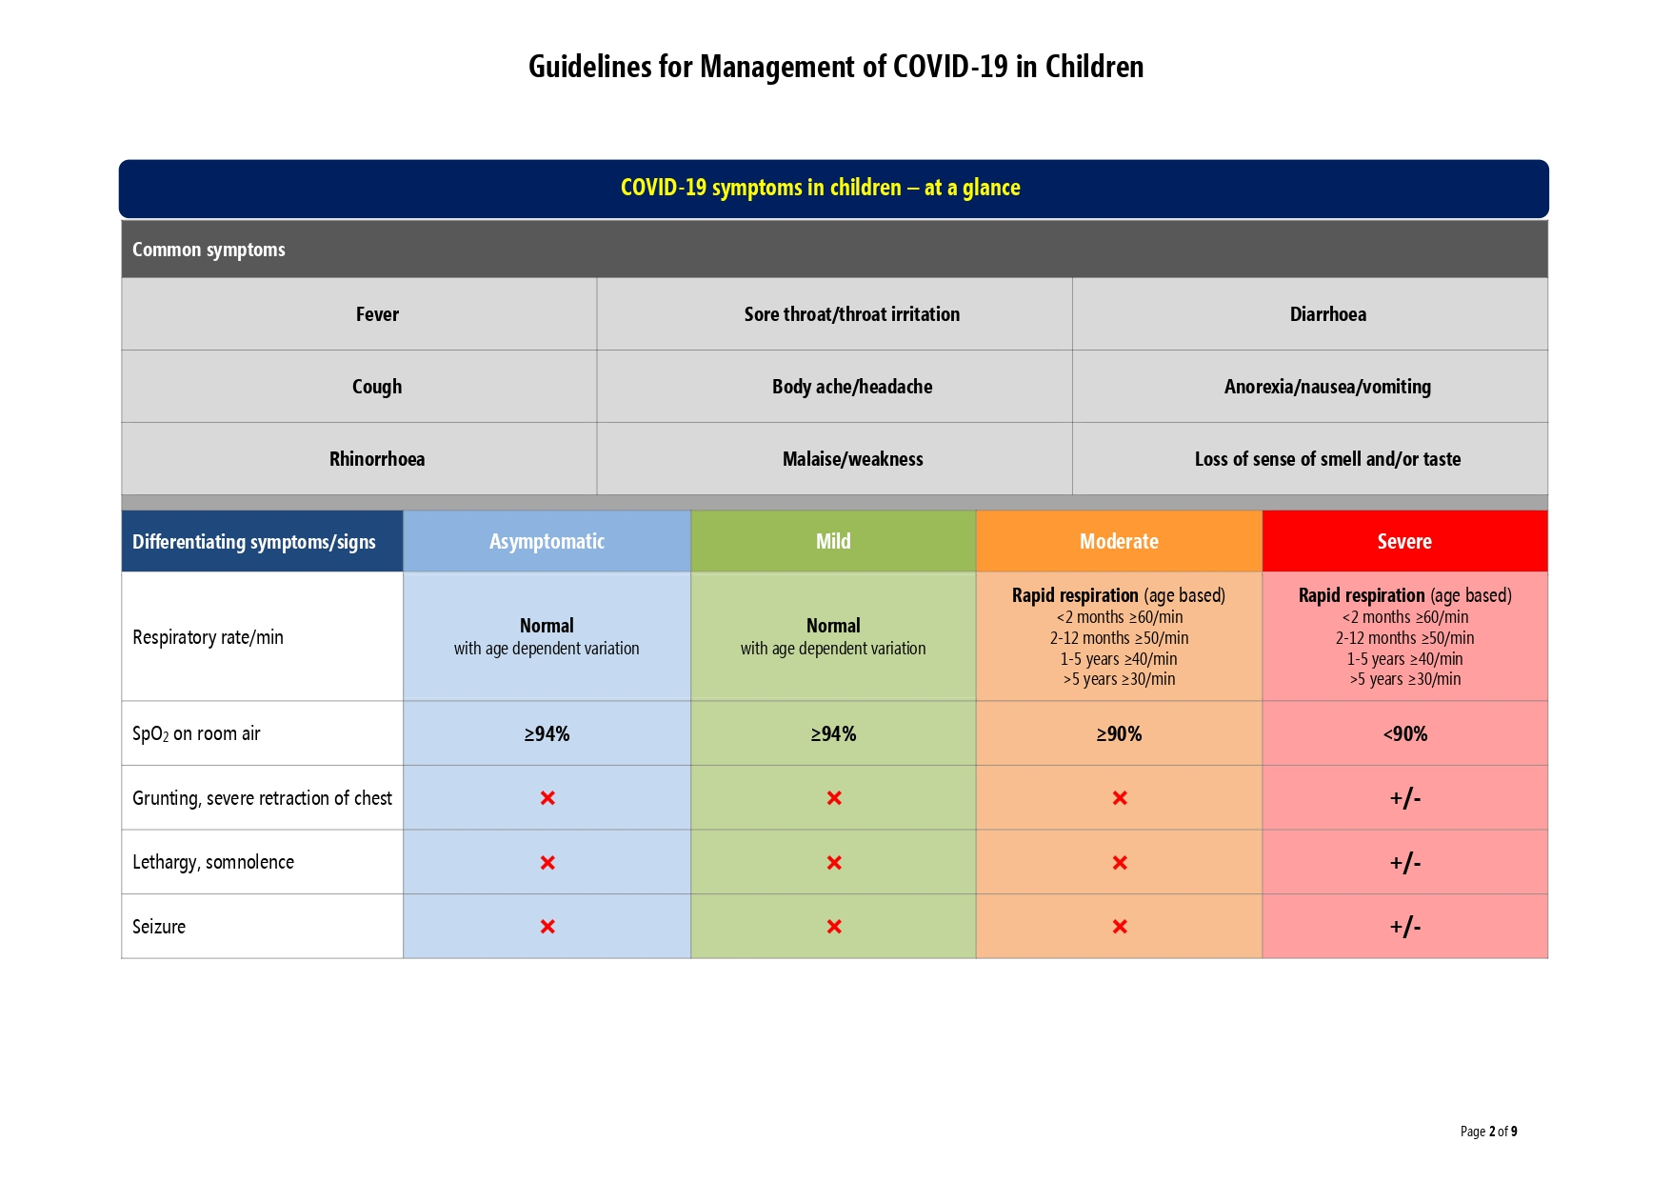

Slide 58
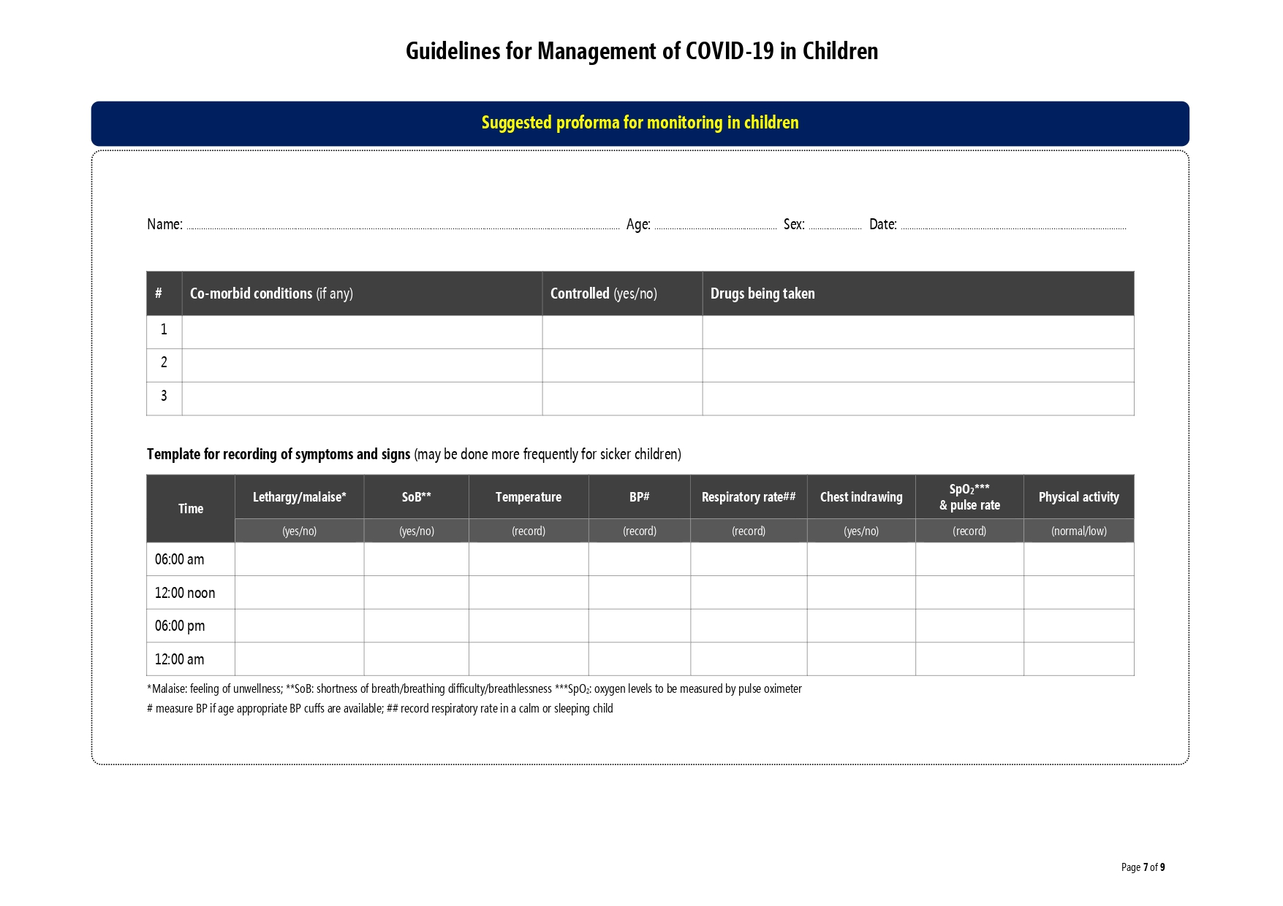

Slide 59
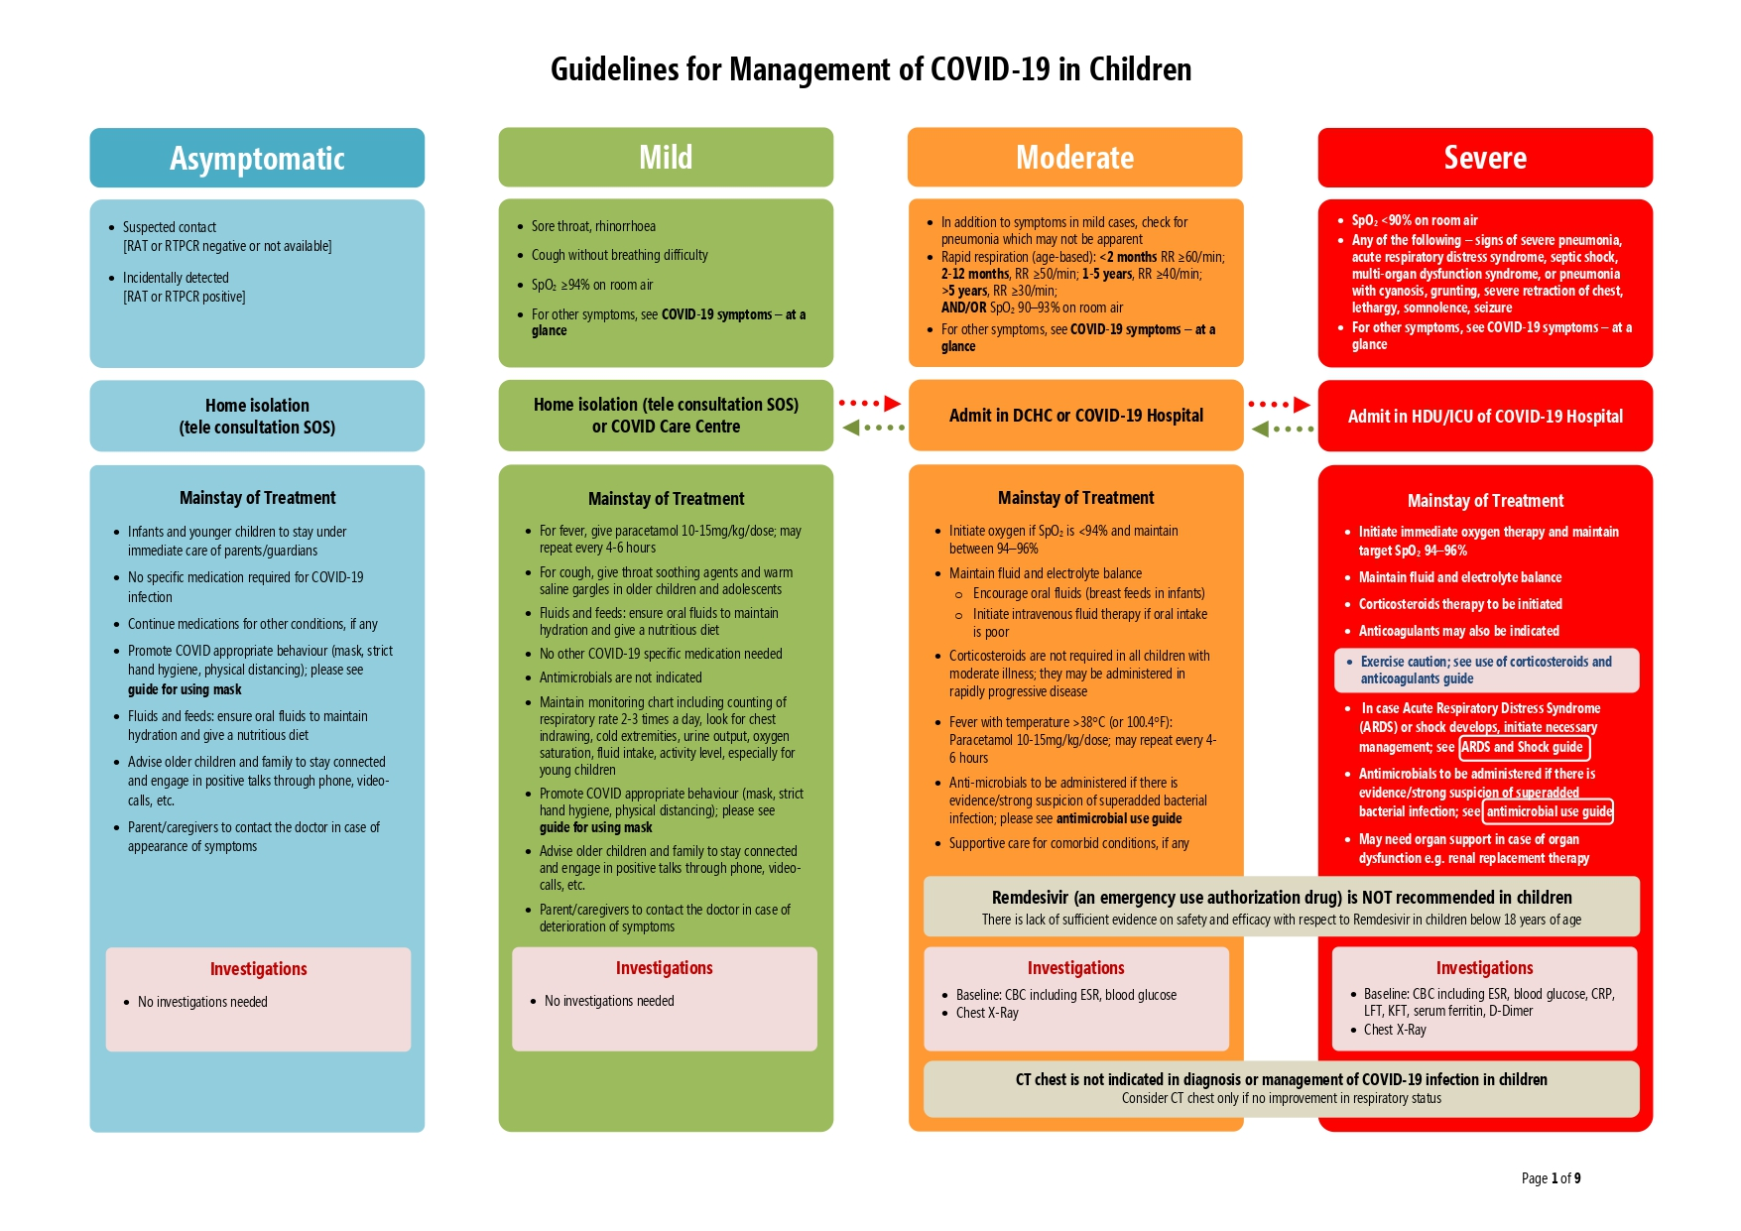

Slide 60
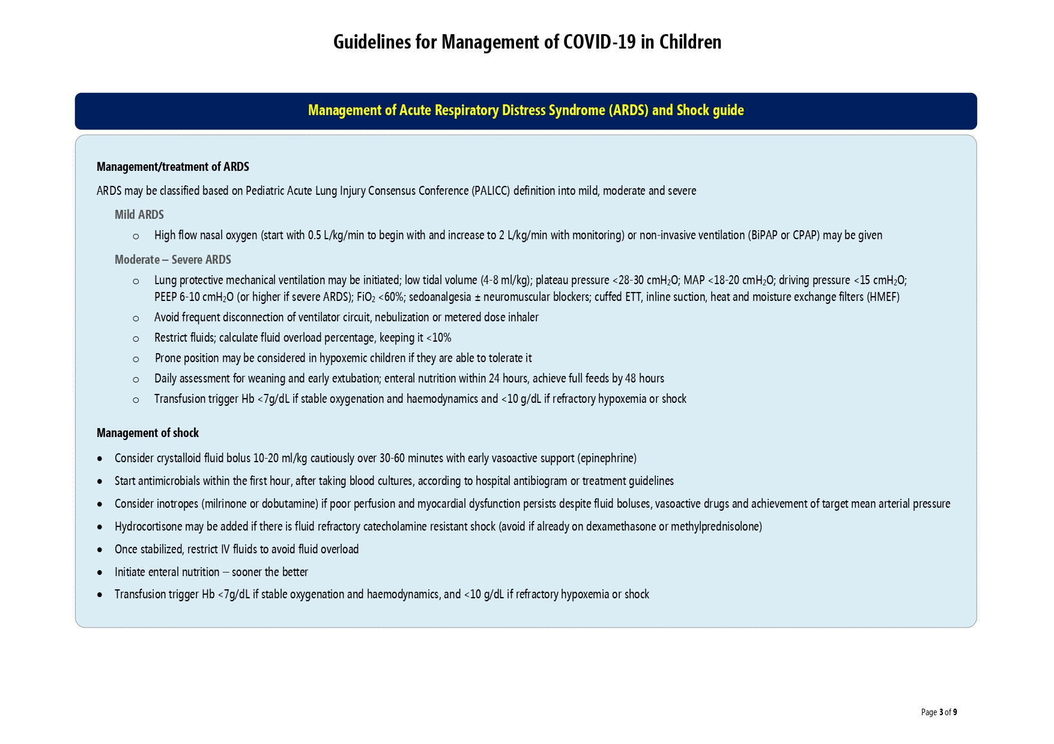

Slide 61
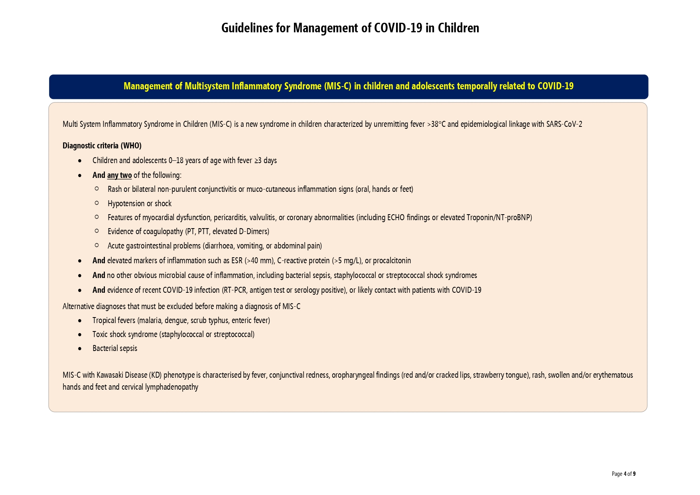

Slide 62
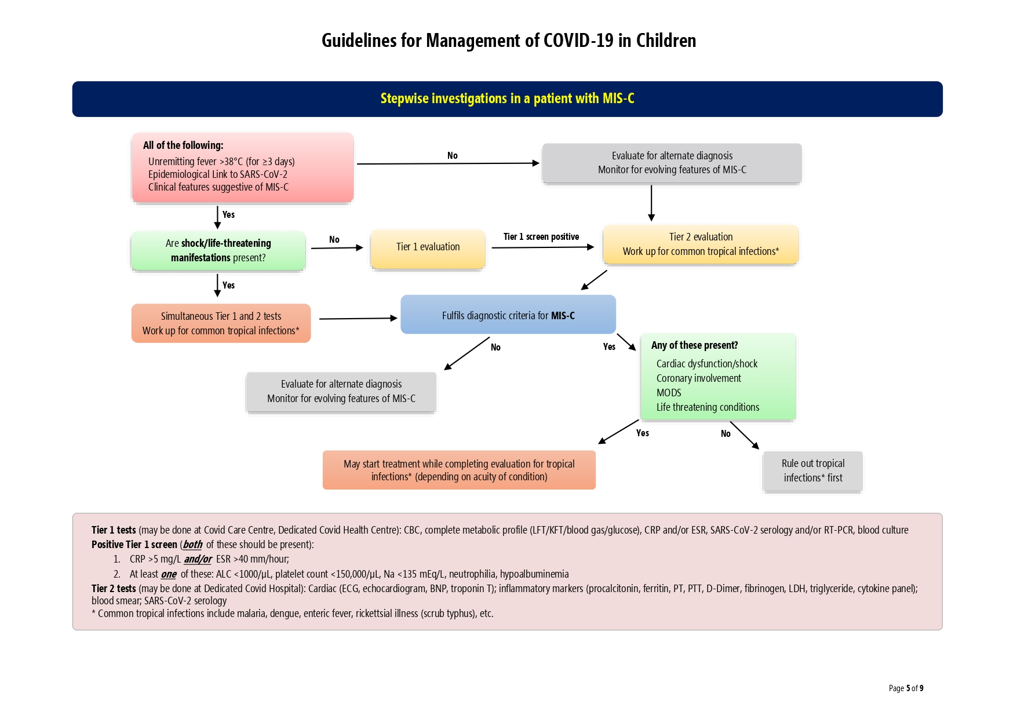

Slide 63
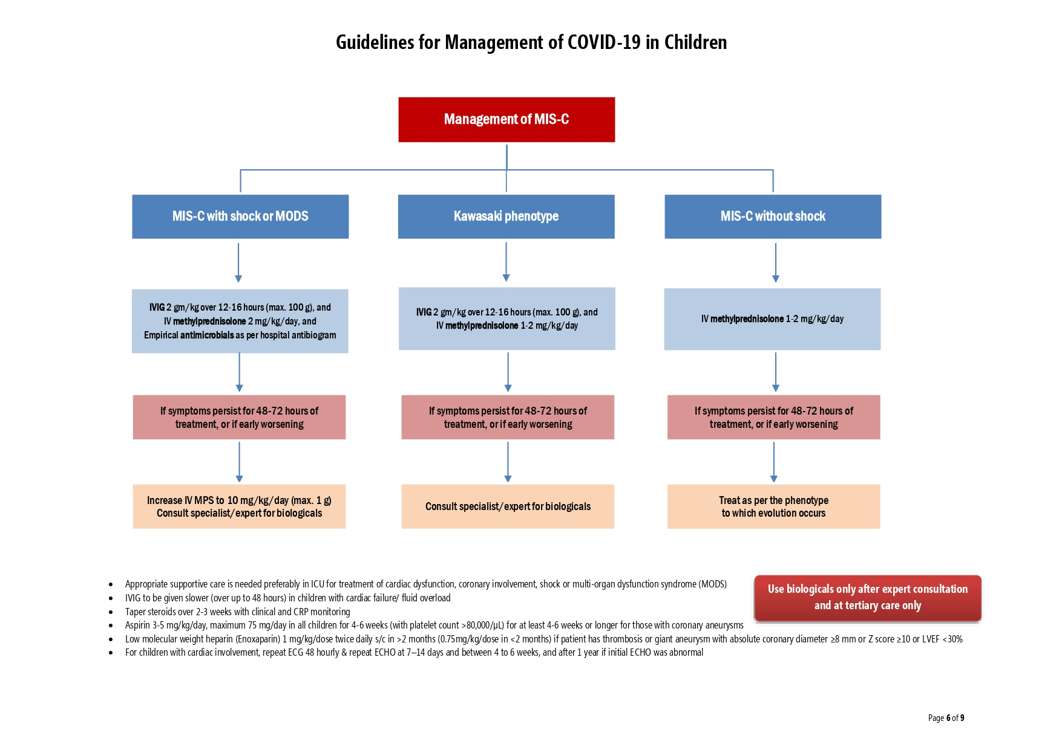

Slide 64
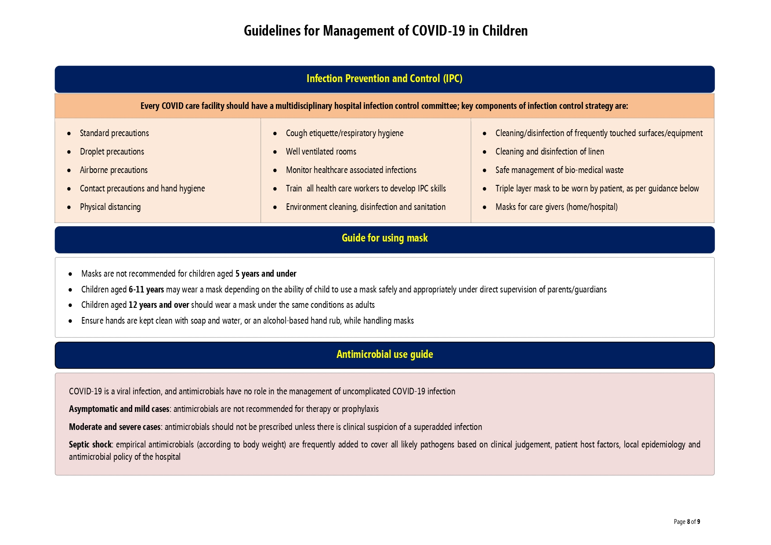

Slide 65
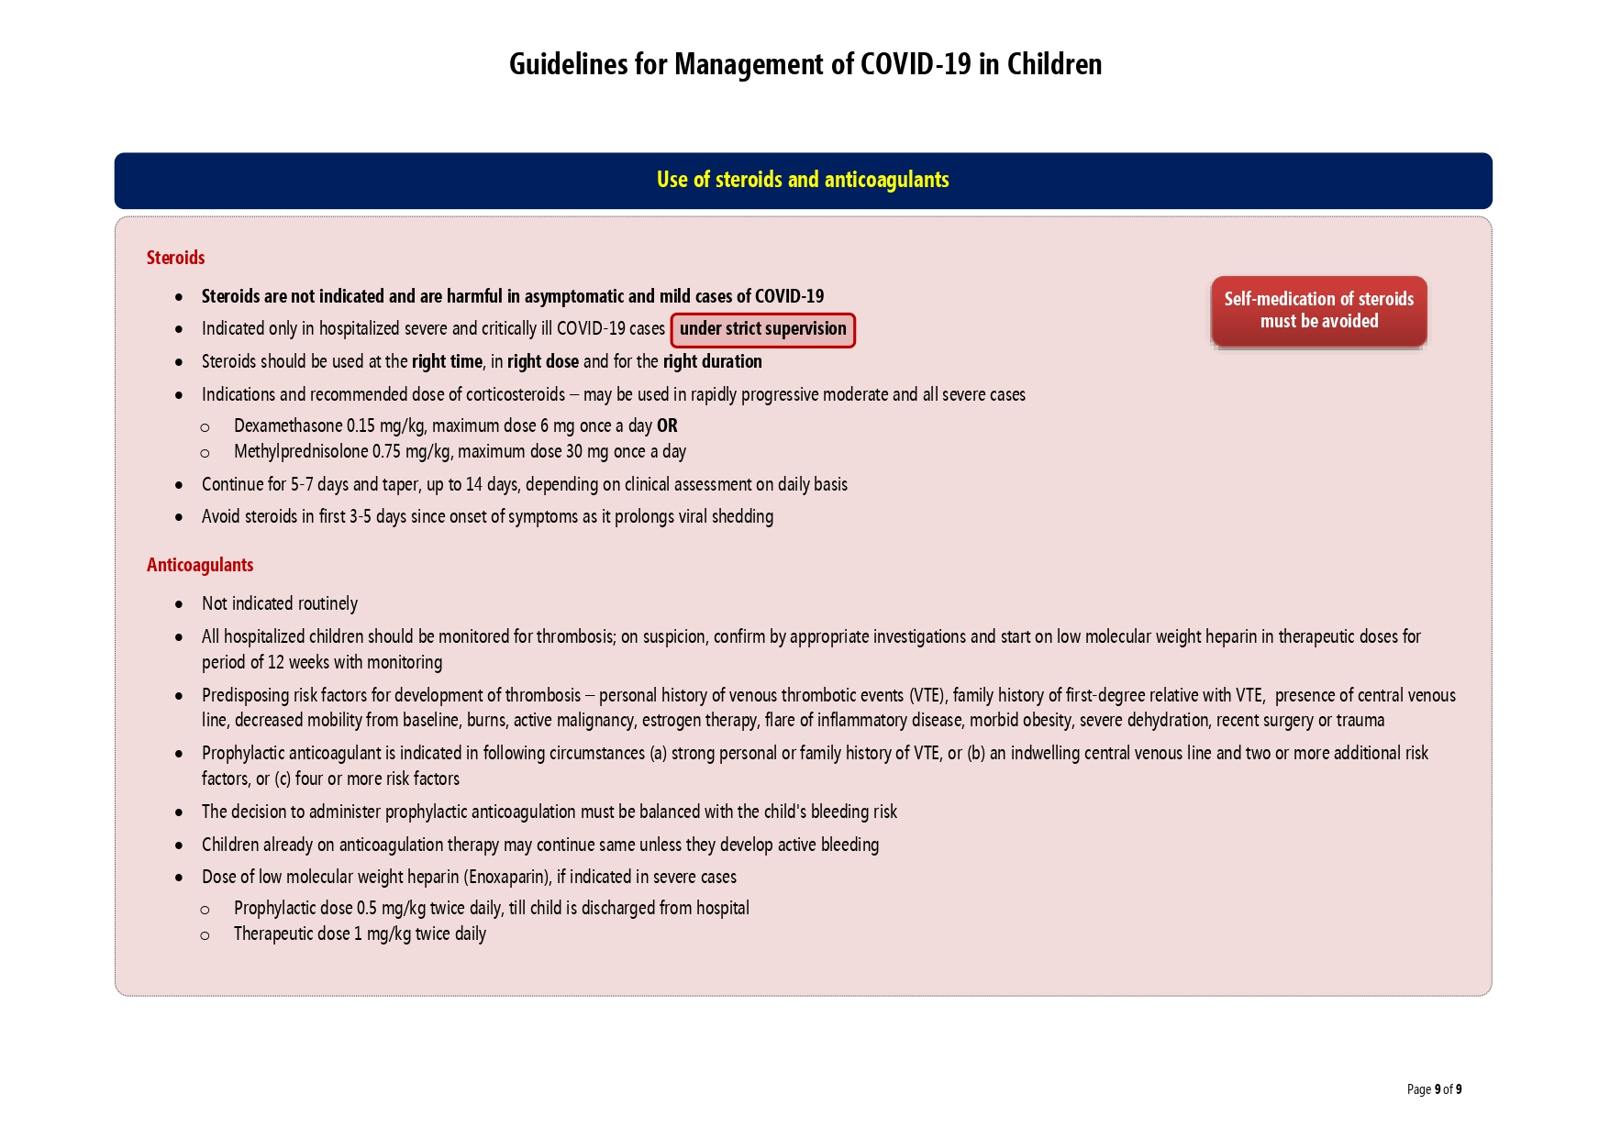

Slide 66

COVID-19: 10 things I wished I’d known some months ago

Slide 67
Prepare And Anticipate. Discuss Logistics Of Upscaling The Number Of ICU Beds And Necessary Resources.
Start Training Residents, Non-icu Nurses In Advance.
Patients Come In With A High CRP And Low PCT. Over The Days, Typically CRP Decreases, While Increases In PCT May Be Observed That Appear Not To Relate To Bacterial Infection.
There Is Highly Fluctuating Fever.
Typically, Patients That Can Be Extubated ‘Early’ (After Approximately 10 Days) Show Decreasing CRP And Temperature Kinetics.
Empirical Therapy Using Antibiotics With Activity Against Both Typical And Atypical Respiratory Pathogens Should Be Considered.
Cytokine Elevation Profiles Appear Reminiscent Of Secondary Hemophagocytic Lymphohistiocytosis (HLH), Or Macrophage Activation Syndrome (MAS). However, While Ferritin Values Are Clearly Elevated.
D-dimer Values May Reach Extremely High Levels, And Hypercoagulation Is Discussed.
There Is A High Incidence Of Thrombosis And Pulmonary Embolism.
Patients With Preexistent Cardiovascular Disease Are Prone To Hemodynamic Decompensation. In Addition To Acute Coronary Syndrome, Fulminant Myocarditis May Occur.

Slide 68
So far, no specific treatment has shown clinical benefit. Use of unproven therapies requires informed consent and clearly also carries risks that should be discussed with the patient/ family, while desperation may drive physicians to try therapies that are backed by little or no evidence.
The use of steroids during refractory shock is advocated

Slide 69
NEW INNOVATIONS
I Devised The Portable Automatic CPR Machine for Covid
Sealed Storage
Waterproof Seal
Fully Integrated PC Automated System Control
Sealed Storage
Oxygen Tank With Separate Control Knobs
Portable E.C.G.
Portable Defibrillator
Stability Slide Locks
Lid With Rubber Cushioning
Quick Lock / Release Handles For Pivot Frame
(Unlocked Position Shown)
Before Pivot Frame Movement

Slide 70


Slide 72
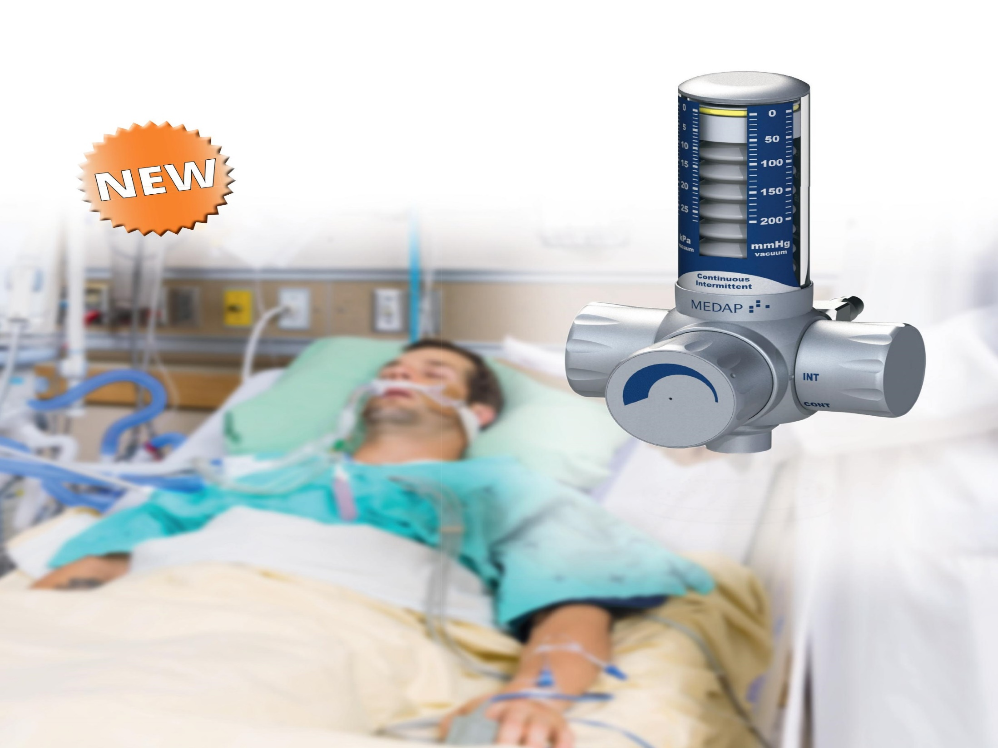
Automatic Suction Machine

Slide 73
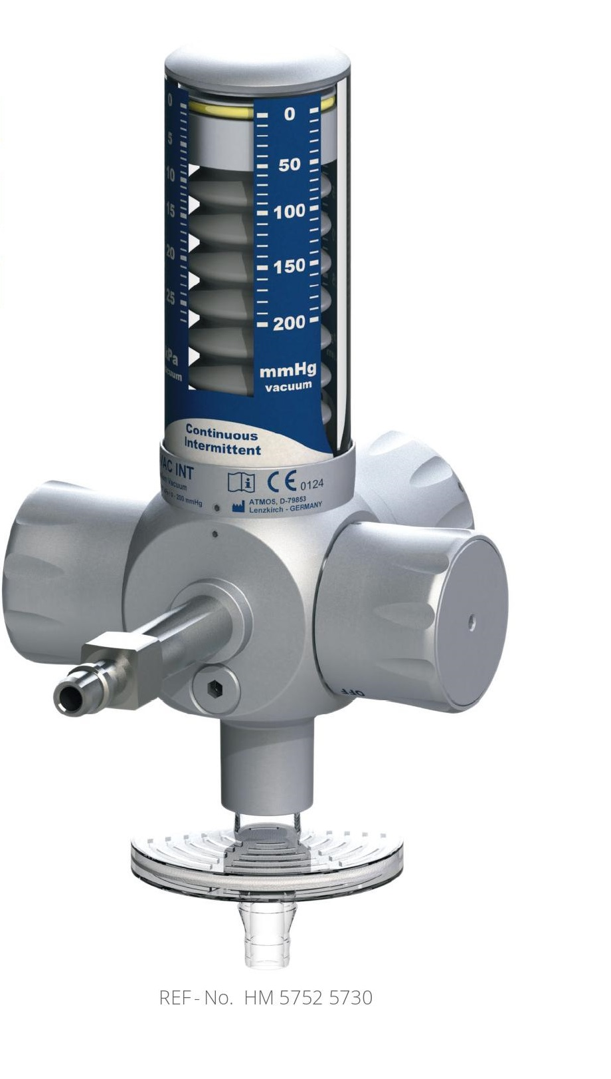

Slide 74
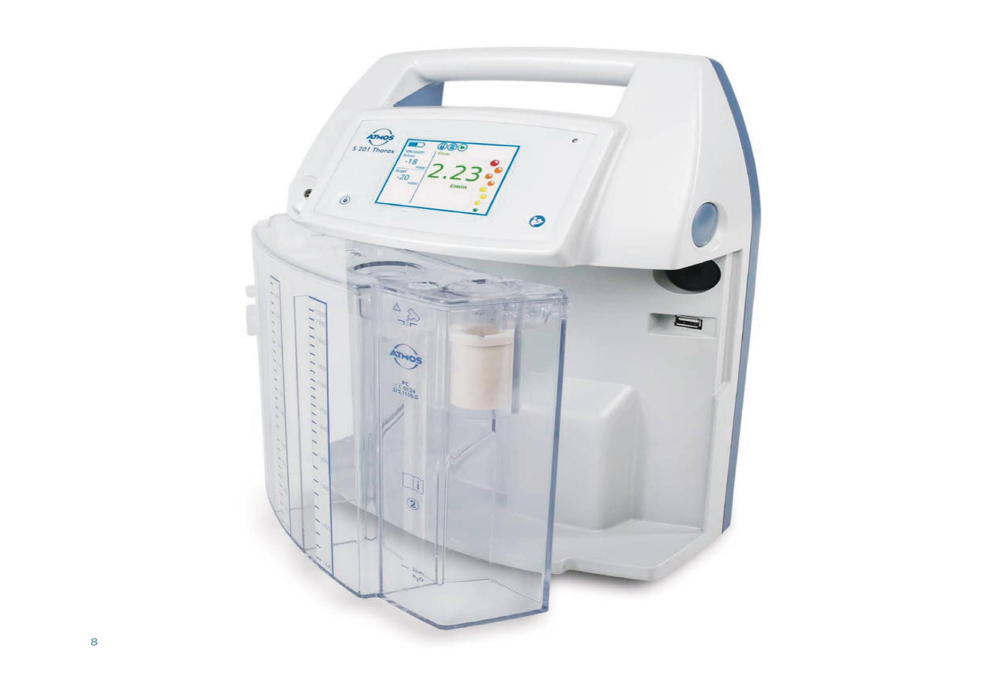
Cardio Thoracic Drainage

Slide 75


